Slide 1
Grain Fortification to Address the SDGs
Speaker Name
Title
Day Month Year
Notes:
See accompanying piece for this at: http://ffinetwork.org/callouts/images/Fortifiation_and_SDGs.pdf

Slide 2

Overview of Sustainable Development Goals
https://sustainabledevelopment.un.org/sdgs
Notes:
The United Nations adopted 17 Sustainable Development Goals (SDGs) in September 2015 with 169 targets. Meeting these targets by 2030 as hoped will require multiple strategies. In many countries fortifying commonly consumed grain products would be a practical step toward meeting the SDGs.
Reducing vitamin and mineral deficiencies is an important tool in achieving the Sustainable Development Goals. Fortification is a relatively inexpensive strategy, benefiting everyone who eats fortified rice or food made with fortified flour, plus it does not require the consumer to change any behavior.
CLICK
Following are details showing how eight of the SDGs can be addressed with grain fortification, which most often includes adding iron, zinc, and the B vitamins folic acid, niacin, riboflavin, thiamin, vitamin B12 and vitamin B6 to wheat flour, maize flour, or rice. The partnership called for in SDG 17 is also a critical component of successful fortification programs.

Slide 3
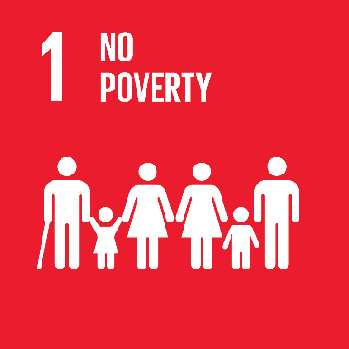
SDG 1. No poverty
Anemia
↓ Productivity
↓ Mental capacity
↓ Academic performance
Wages↓ 2.5%
Notes:
Anemia is estimated to contribute to 17% lower productivity in heavy manual labor and 5% lower productivity in other manual labor. A modeling exercise in India estimated that a birth cohort of individuals with iron-deficiency anemia (IDA) in 2013 will lose more than US$ 24 million over their lifetimes as a result of productivity loss due to IDA.
Additionally, the mental capacity that is undeveloped when children are iron deficient affects their academic performance. Childhood anemia is associated with a 2.5% drop in wages in adulthood, affecting both productivity and economic growth.

Slide 4
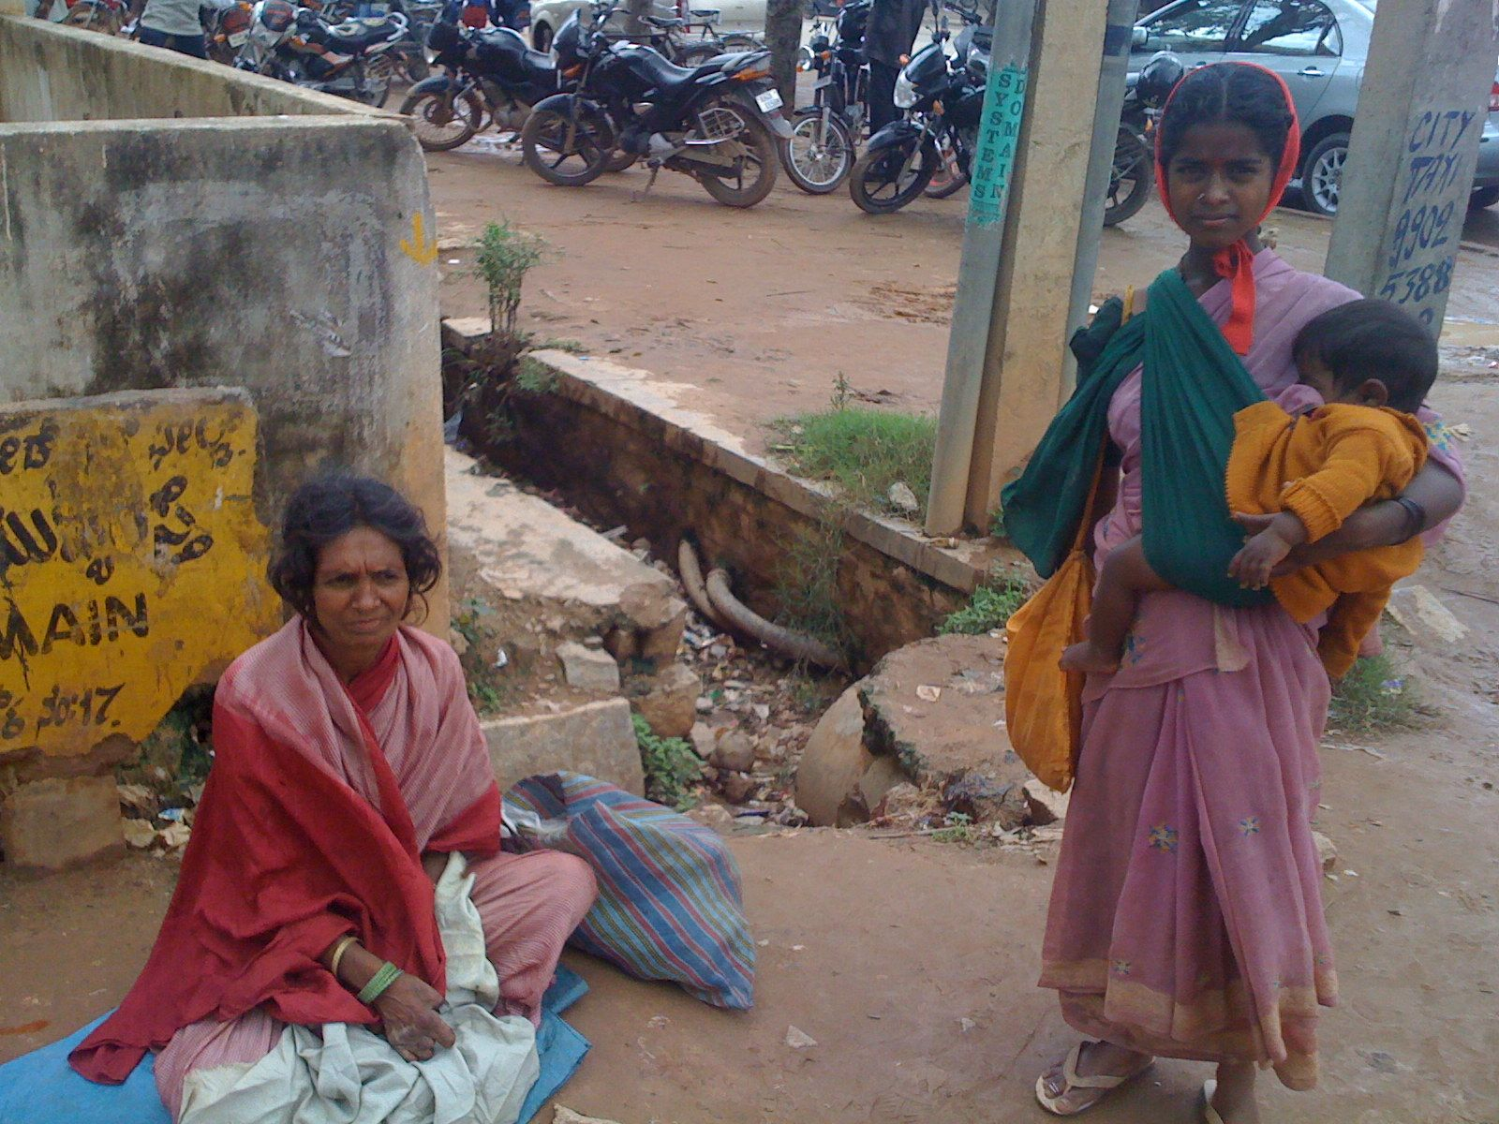
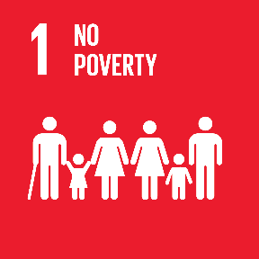
Fortifying grains to address nutritional anemia
Anemia can be caused by deficiencies of:
Iron
Folic acid
Riboflavin
Zinc
Vitamin B12
Fortifying with these nutrients reduces the risk of nutritional anemia
Flickr photo by Sean Ellis
Notes:
Nutrient deficiencies that can contribute to anemia include iron, riboflavin, folic acid, zinc, and vitamin B12. Currently, more than 80 countries have legislation to add one or more of these nutrients to wheat flour, maize flour, and/or rice. Adding these nutrients to commonly consumed grains is one step toward improving productivity and thereby reducing poverty.
Photo: https://www.flickr.com/photos/s_w_ellis/3121448232/in/photolist-5KQeNY-zniJ8-fuvab-nYYeCA-6eVTHa-DZBnHN-21n5qF-xpxrY-xpxqd-xpxvZ-26tbY-xpxsq-c8RkTw-7o1mc-7xrQ2t-xpxtL-77EwMQ-dXA6vq-4kjJ4A-nm1xYi-a2PYG3-xpxwq-xpxvJ-xpxot-oZRDpD-4wACdz-5JTFdM-mmuBc2-2Uk1an-m8s27-KbpyQ-5pwwSb-pg47t2-7SBH7y-dGWMZm-eBYRJ-4SmyNK-4fDkT7-eQxJXM-eQxJw2-frJ4J-Kbs6q-rYhcE-c53VQL-C56yc-76RNmd-pei8oh-37iii-5My6B5-7dUho1

Slide 5
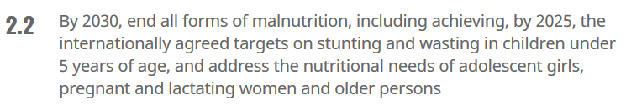
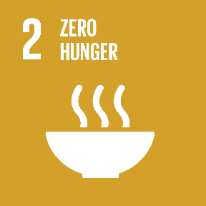
SDG 2. Zero hunger includes malnutrition
45%
of all deaths of children under 5 are attributed to malnutrition
2017 Global Nutrition Report
Notes:
The target of SDG 2.2 is to end all forms of malnutrition. Of all deaths of children under 5 years, 45% are attributed to malnutrition. This goal specifically mentions stunting. Vitamin and mineral deficiencies increase the risk of stunting which affects about 2 billion people.
Fortification is one of the most effective nutrition interventions in preventing nutritional deficiencies, thus working to reach SDG 2.2.

Slide 6
Increased productivity from improved nutrition also addresses hunger
Sufficient Nutrient Intake
↑Productivity
↑Agricultural Production
↑ Food Supply
Help End Hunger
2017 Global Nutrition Report
Notes:
Additionally, adequate nutrient intake increases productivity in adults, leading to improved productivity in agricultural labor. This will increase agricultural production, subsequently providing growth in the food supply and helping to combat hunger.
Fortification is one of the most effective nutrition interventions in preventing nutritional deficiencies, thus working to reach SDG 2.2.

Slide 7

SDG 3. Good health and well-being
Maternal and newborn health
Infectious diseases
Non-communicable diseases
Notes:
This goal focuses on maternal and newborn health, infectious disease, and non-communicable diseases. Fortification helps to reach goals in each of these categories.
Photo of mother with child: iStock
Mosquito Photo: https://www.flickr.com/photos/cdcglobal/9661967327/in/photolist-fHN7gz-fHN7oz-oQzMc-41aaN-dqVpTe-7LEwBm-jZcdSZ-3im2cg-jZaMG2-dqVpB4-nGYKh5-cVA4Gy-jZaMgx-7LEwC5-BZHbE-5YodRk-aFaDrM-m6unP-HMQug-896rzu-apE7ru-jZbib2-9LudxV-6J5oGG-rnYLUa-D3RrYH-nqvPRv-C6mxZ7-nqw5bR-CAKhXu-eQtqvQ-C6tCaM-ehq2PX-4zCmrg-C6ta9H-nGYKMy-7DyE2Y-nqvHzb-nEXJwo-jZbqS4-PmBSP-nGP6wm-nGHtLH-fAytcL-CVywLR-hisQKM-nqvHqo-CTioTj-scdfU1-jZdsKN
Bottom photo: https://www.flickr.com/photos/dfid/5815109875/in/photolist-9RRXz6-b3Par8-dQugc2-dQugaP-5knR8g-5gikg-qWapYK-9yQa4f-rdAmgr-uvgpxZ-HXMAo-qW1o41-FkNPUx

Slide 8
Nutrients commonly used in grain fortification improve maternal and newborn health
Folic acid
Iron, folic acid, riboflavin, zinc, vitamin B12
↓ risk of brain and spine birth defects
↓ risk of maternal and perinatal mortality from nutritional anemia
↓ risk of low birth weights from maternal anemia
Notes:
A huge advantage of fortifying with folic acid is the reduced risk of birth defects of the brain and spine. One meta-analysis showed that fortifying wheat flour with folic acid reduced the incidence of these birth defects by an average of 46%.
Anemia during pregnancy increases the risk of maternal and perinatal mortality. Anemia during pregnancy also contributes to low birth-weight infants. Newborns that are born small are prone to death and diseases while they are young. If they survive, they are at an increased risk for poor mental development in childhood and chronic health problems such as diabetes and heart disease later in life

Slide 9
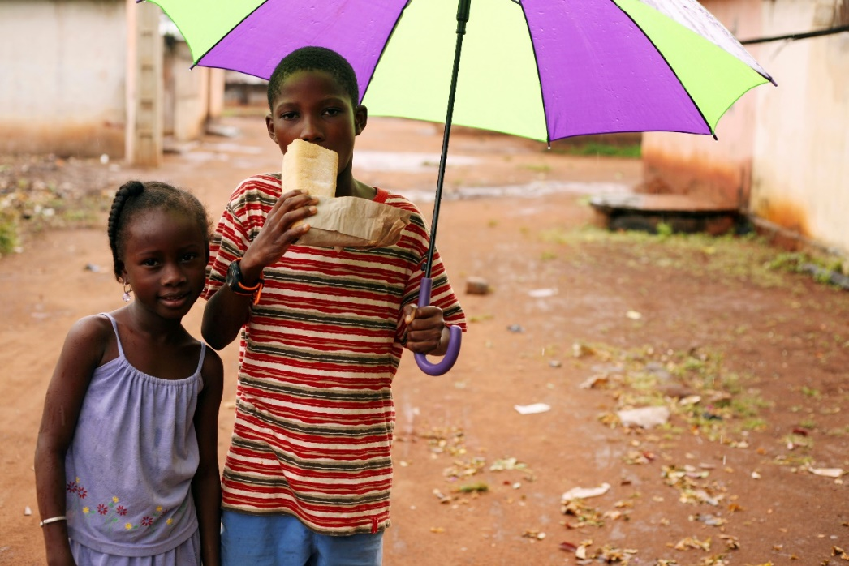
Zinc and infectious disease
17% of global population is at risk for inadequate zinc intake¹
Zinc deficiency is responsible for 18% of malaria cases²
Fortifying with zinc has improved zinc status in Cameroon³ and Fiji⁴
iStock Photo
¹ Estimating the Global Prevalence of Zinc Deficiency: Results Based on Zinc Availability in National Food Supplies and the Prevalence of Stunting
² World Health Organization
³ Iron, Zinc, Folate, and Vitamin B-12 Status Increased among Women and Children in Yaoundé and Douala, Cameroon, 1 Year after Introducing Fortified Wheat Flour
⁴ Impact of Iron Fortified Flour in Child Bearing Age (CBA) Women in Fiji 2010 Report
Notes:
Zinc is a mineral that promotes immunity, resistance to infection, and proper growth and development of the nervous system, and is integral to healthy pregnancy outcomes. Zinc deficiencies increase risk of malaria, pneumonia, and diarrhea.
In a 2012 paper, researchers concluded that 17% of the global population is at risk of inadequate zinc intake. WHO estimates that worldwide, zinc deficiency is responsible for 18% of malaria cases.
Both Cameroon and Fiji have reported improvements in the population’s zinc status after grain fortification began.

Slide 10
Nutrition and non-communicable diseases
Anemia
Iron
Diarrhea
Zinc
Vitamin A
Riboflavin
Folic acid
Zinc
Vitamin B12
Notes:
Anemia is a non-communicable disease. Nutritional anemia is caused by vitamin and mineral deficiencies, and adding iron, riboflavin, folic acid, zinc, and vitamin B12 to food during the milling process helps reduce the risk of nutritional anemia.
Another non-communicable disease is diarrhea. A study published in in June 2017 noted that diarrhea remains a leading cause of death globally. While unsafe water and unsafe sanitation remain the leading risk factors, vitamin A and zinc deficiencies also contribute to diarrhea.

Slide 11

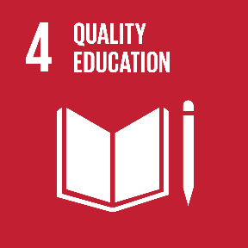
SDG 4. Quality Education
Poor iron status in childhood limits cognitive development
iStock Photo
Notes:
While iron deficiency limits cognitive development, children who have adequate iron have more energy to participate in classroom exercises, and they are more mentally prepared to master the material.

Slide 12

SDG 5. Gender equality
High anemia rates in females
Menstruation
Affects academic performance
Fortifying with iron
↓ nutritional anemia
Increased gender equality
↑ academic performance
↑ work productivity
Notes:
Anemia rates in females are much higher than males. While anemia rates decrease for males by the end of puberty, they remain high for females through reproductive years due to menstruation.
Therefore, reducing anemia by fortifying with iron contributes to boosting females’ relative academic performance and worker productivity and helps achieve gender equality.

Slide 13
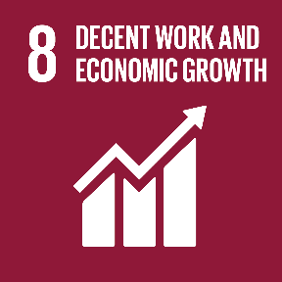
SDG 8. Decent work and economic growth
16:1
benefit to cost ratio in fortifying foods in low and middle income countries
2017 Global Nutrition Report
Notes:
The 2017 Global Nutrition Report states there is a 16:1 benefit to cost ratio in fortifying foods in low and middle income countries.
This is especially apparent when spina bifida is prevented. Adults who care for children with spina bifida spend time making medical appointments, taking children for treatment, and helping children with many daily activities such as toileting and mobility. Adults with spina bifida are very often independent and productive, but they usually require ongoing and often intensive medical care.
A study of 88 people in Germany with spina bifida found that physiotherapy was the most used healthcare resource, and more than half the study participants used a wheelchair. The authors concluded that their care givers "might have to either adjust their careers overall or adjust their working schedule, resulting in productivity losses".

Slide 14
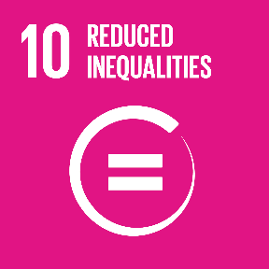
SDG 10. Reducing inequalities
High Income Countries
Less risk
Fewer nutrient deficiencies
Low and Middle Income Countries
Risk of death, morbidity, susceptibility
Higher stunting rates
Most burden of nutrient deficiencies
Notes:
Low- and middle-income countries bear most of the burden in nutrient deficiencies. This increases the risk of death, morbidity, and susceptibility to negative health outcomes that could be mitigated.
The 2008 Copenhagen Consensus ranked fortification as the third greatest opportunity to fight development challenges, highlighting the opportunities for iron fortification. Fortifying with folic acid can decrease birth defects overall regardless of economic status of a country.

Slide 15
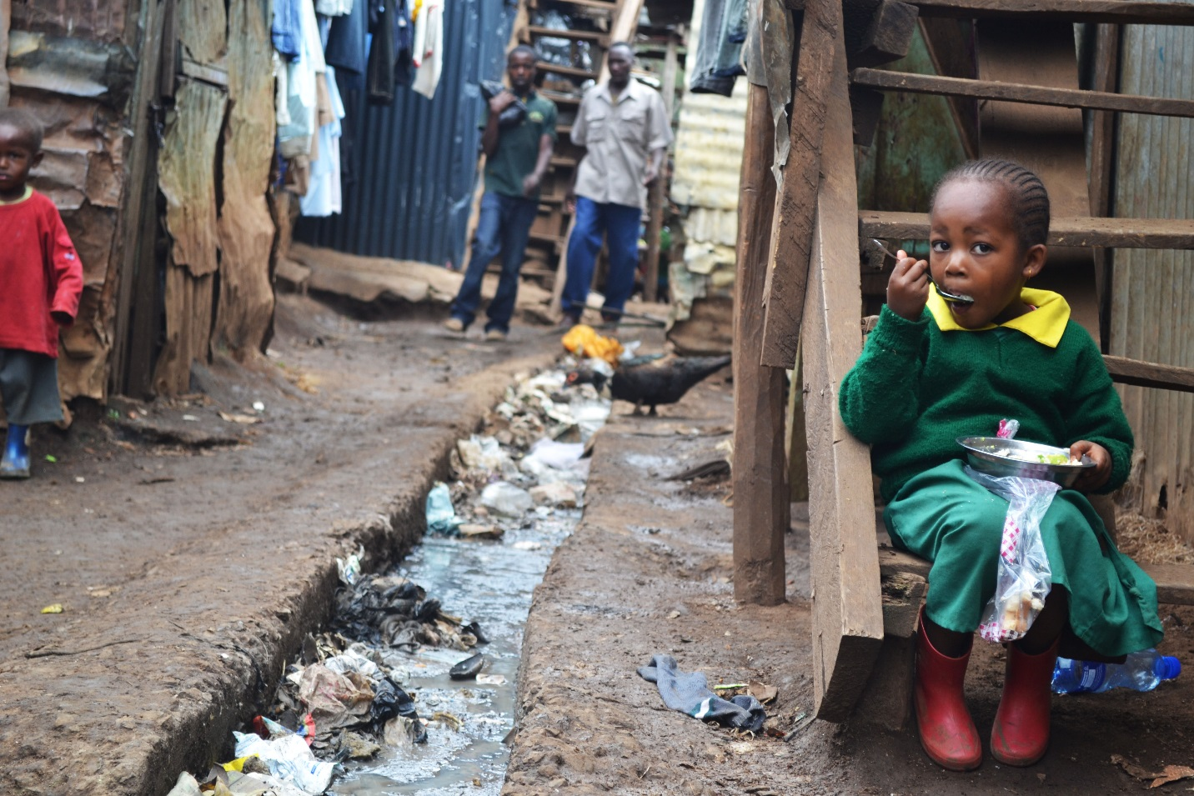

SDG 11. Sustainable cities
Nairobi slum photo by Trocaire on Flickr
Notes:
More people now live in cities than rural areas, and 30% of urban dwellers live in slum conditions.
Urban residents are likely to benefit from fortification of industrially milled flour and rice. Consequently, grain fortification is an opportunity to improve the nutrient intake of a significant proportion of the population, including the urban poor who shop in informal markets.

Slide 16
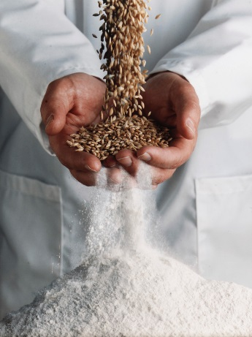

SDG 17. Partnership for the goals
Influential individual
Institution with research capacity
Food industry
Policy makers
Other agencies
Support fortification
Monitor impact
Fortify food
Ensure mandatory fortification
Monitor and ensure compliance was enforced
Components of Successful Staple Food Fortification Programs: Lessons From Latin America iStock Photo
Notes:
While adding essential nutrients to food addresses the above SDGs, maintaining a successful fortification program requires the partnerships called for in this goal. Effective partnerships are essential for food fortification because no sector can be successful on its own.
A variety of players were responsible in creating effective fortification programs, including:
An influential individual to support fortification
An institution with research capacity to monitor impact
Food industry to fortify food
Policy makers who ensure fortification was mandatory nationwide
Other agencies to monitor and ensure compliance was enforced

Slide 17
SDG 17. Partnership for the goals
Private Sector
Public Sector
Civic Sector
Fortification Success
Notes:
Creating and maintaining effective partnerships is a high-maintenance activity. The first recommendation to any country considering fortification is to form a national alliance. Seek participation and commitment from national leaders representing public, private, and civic sectors. Be sure each stakeholder understands the health and economic benefits for fortification. Involving all sectors early in the process prevents overlooking key information. It also builds commitment from each group to work toward success.
The Food Fortification Initiative brings partners together with the goal of reducing vitamin and mineral deficiencies through food fortification. In doing so, the partners are also taking steps to address nine of the 17 SDGs.

Slide 18

For more information:
http://ffinetwork.org/callouts/images/Fortifiation_and_SDGs.pdf
https://sustainabledevelopment.un.org/
E-mail info@ffinetwork.org
Also see:
FFInetwork.org
Facebook.com/FFInetwork
Twitter.com/FFInetwork
And join our group on LinkedIn
How to cite this document: Food Fortification Initiative (FFI), Organization Title (if applicable). Title of Document. Atlanta, USA: FFI, Year. Available from www.FFInetwork.org. Accessed on [date].

