Slide 1


Fortified Flour
Dr. Moataz Saleh
March 2021
“Food Systems Delivering Affordable Healthy Diets”

Slide 2
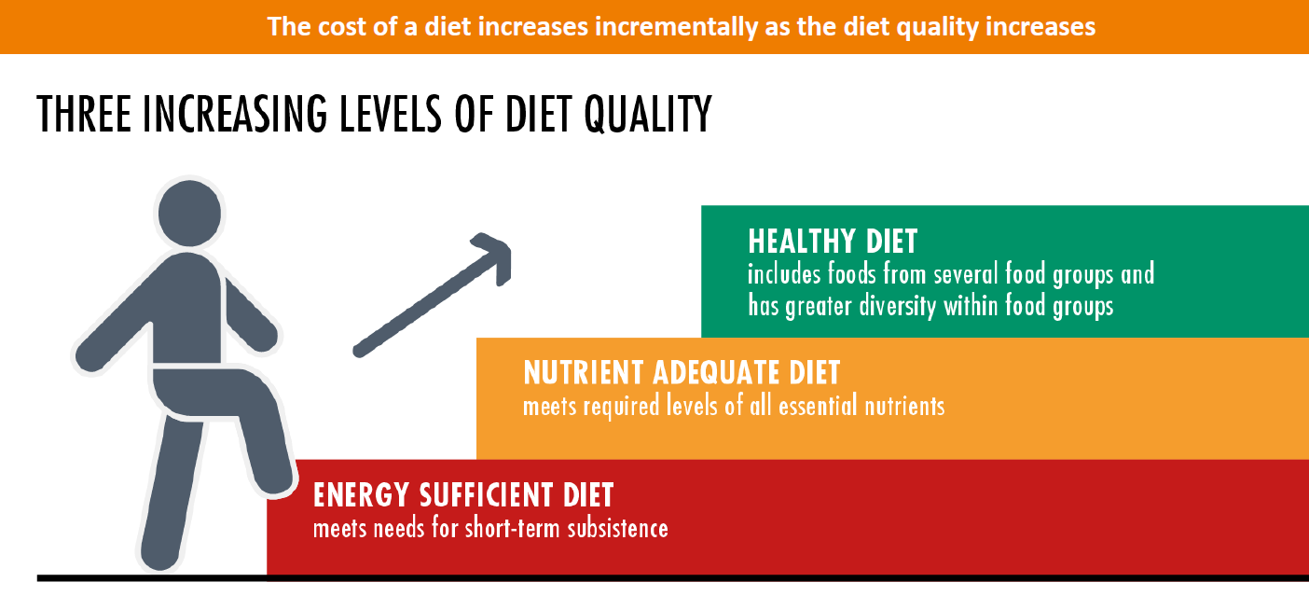
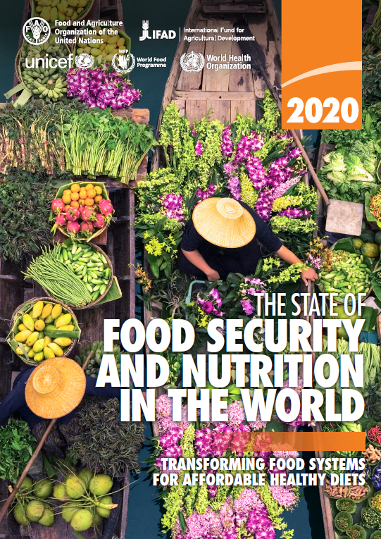
Basic Facts on Feeding & Nutrition
A HEALTHY DIET: Is one that helps to protect against malnutrition in all its forms, as well as noncommunicable diseases (NCDs), including such as diabetes, heart disease, stroke and cancer (WHO definition)
Where do micronutrients fall

Slide 3
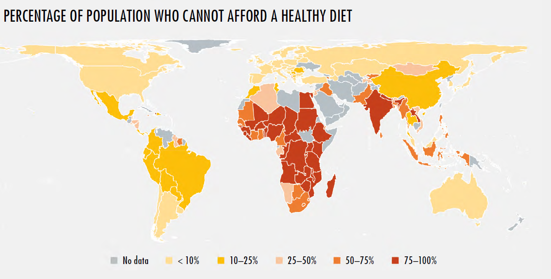
According to the food security report in 2017
81% of Egyptians can not afford a healthy diet and 45% cannot afford a nutrient adequate diet.

Slide 4

Macronutrients Vs Micronutrients
Micronutrients are a groups of nutrients our body needs. They include vitamins and minerals.
They are needed in small quantities to enable the body to produce enzymes, hormones, and other substances that are essential for proper energy production and utilization, immune functions growth and development.
Iodine, vitamin A, and Iron are the most important in global public health terms; their deficiency represents a major threat to the health and development of populations worldwide, particularly children and pregnant women in low-income countries.
Notes:
Micronutrients are vitamins and minerals needed by the body in very small amounts. However, their impact on a body’s health are critical, and deficiency in any of them can cause severe and even life-threatening conditions. They perform a range of functions, including enabling the body to produce enzymes, hormones and other substances needed for normal growth and development. Deficiencies in iron, vitamin A and iodine are the most common around the world, particularly in children and pregnant women. Low- and middle-income counties bear the disproportionate burden of micronutrient deficiencies.
Micronutrient deficiencies can cause visible and dangerous health conditions, but they can also lead to less clinically notable reductions in energy level, mental clarity and overall capacity. This can lead to reduced educational outcomes, reduced work productivity and increased risk from other diseases and health condition

Slide 5



Available Data IRON
Percentage of Children Under the Age of Five who are Malnourished, DHS Trend
Percentage of females aged 5-19 years and ever-married women aged 15-49 years who are malnourished, DHS Trend
In 2019 the school screening initiative for stunting, and anemia reported 38% of screened children to be suffering from aneamia

Slide 6

Available Data FOLIC ACID
FOLATE is present in citrus fruits and leafy vegetables, not getting enough folate can lead to a deficiency in just a few weeks.
Folate is Very important in pregnant women to prevent congenital birth defects and its deficiency can affect other systems including blood formation causing anemia
In the Pediatric Hospital Ain Shams University a study between (1995–2009), on 660,280 child aged 0–18 years attending the Hospital found that Neural tube defects was the most common type of congenital malformation 29% of all positive cases.
Could we have averted these cases with the fortification program

Slide 7
How to overcome micronutrient deficiencies
Iron program for pregnant women and children 6-60 month & School aged.
Folic acid program for preg Women.
Vit A program for pregnant women and new born’s.
These programs all have challenges including supply chain and logistics, compliance, reach
Supplementation programs
Increasing the availability of Nutritious divers foods
Fortification Programs
Salt iodization program has been a success and is currently being maintained.
Flour fortification
These programs all have challenges including supply chain and logistics, setup cost, quality control
Most challenging including access and cost, macroeconomic status, agricultural value chain, subsidy systems ect

Slide 8
Fortification is a Low Cost Solutions to Eliminate Micronutrient Malnutrition
Annual Per Capita Cost of Interventions
World Bank 1994

Slide 9

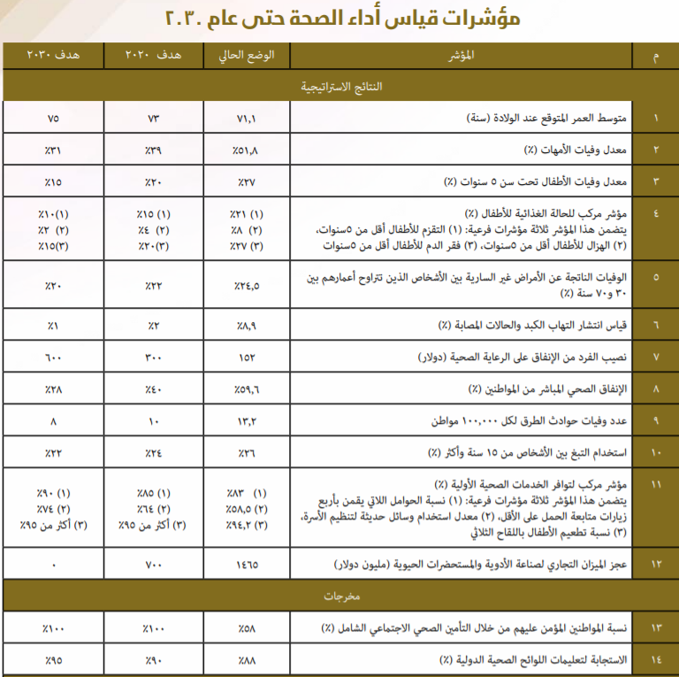
Egypt vision 2030 a national target

Slide 10
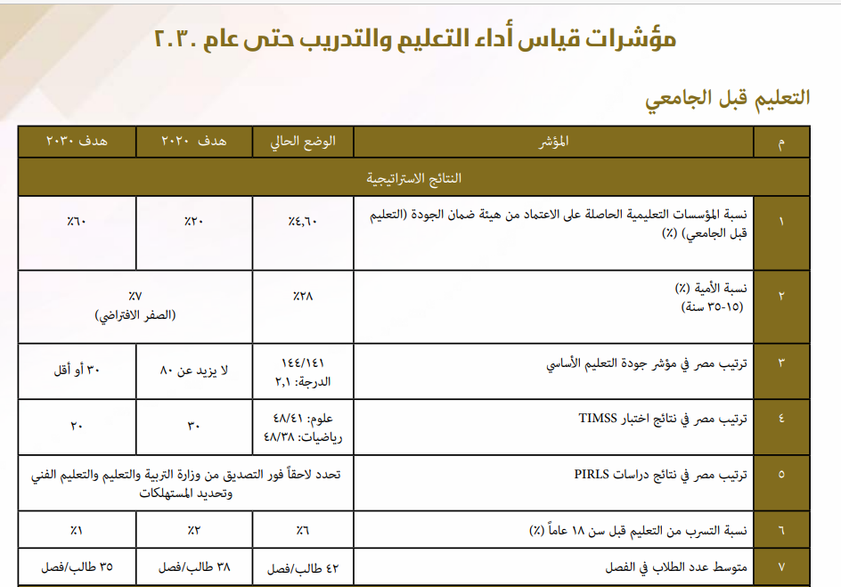
Egypt vision 2030 a national target

Slide 11
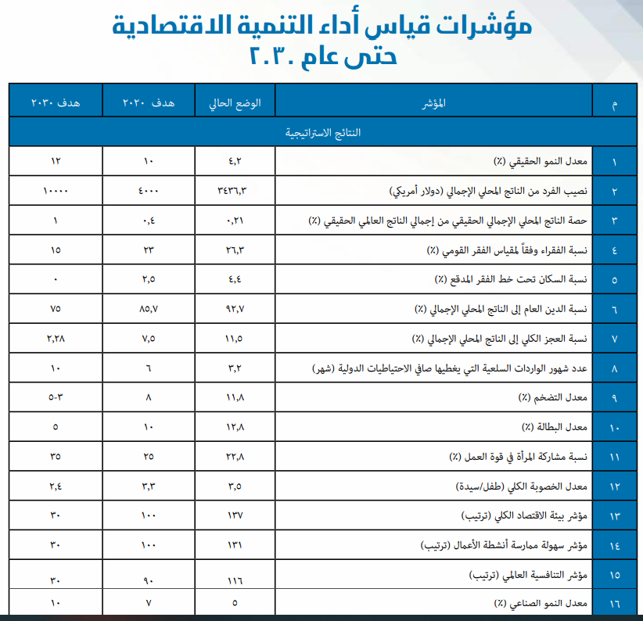
Egypt vision 2030 a national target

Slide 12


