Slide 1

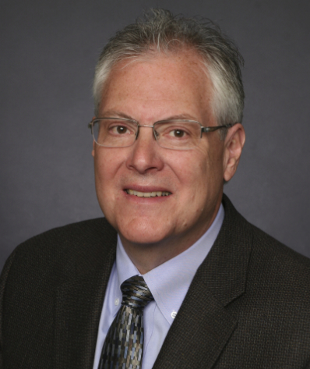

Delivering Nutrition with Bread in Egypt
Presented by Scott J. Montgomery, Director
Food Fortification Initiative
1 April 2021
Photo by Jonathon Hodge @Flickr Creative Commons
Notes:
Greetings from far away and welcome to the wheat flour monitoring training. My name is Scott Montgomery, the Director of the Food Fortification Initiative. I would have liked to join this group of distinguished participants from the Government of Egypt, public and private sector mills, and partner organizations in person. However, with current travel restrictions I am not able to be in Cairo. Instead, I will join the meeting later this afternoon virtually.

Slide 2
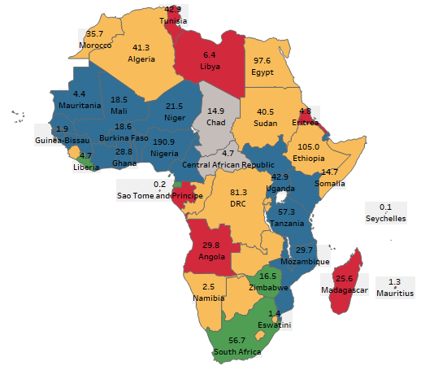
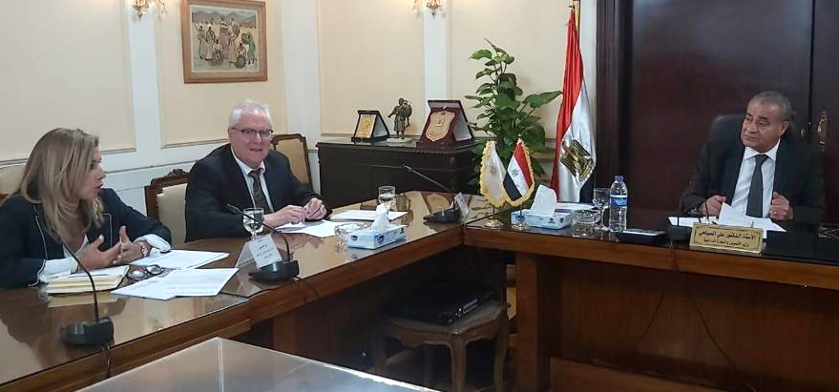
Wheat Flour Fortification Opportunities in Africa, 2018
Color Code Descriptions | 2018 | Total Pop. 2018
Over 75% of industrial-milled flour fortified in country. FFI's main role is monitoring. | 22 | 594,824,775
Confident country will move to 75% by January 2020. Targeted support as needed. | 4 | 79,246,655
Organized efforts to increase fortification within country. Without support to fill gaps, moving to 75% unlikely. | 16 | 477,213,415
No fortification activity in the country. Major support necessary to reach 75% fortification | 10 | 113,843,494
Fortification of wheat and/or maize likely to have very limited health impact; or no data on country | 2 | 19,559,074
Totals | 54 | 1,284,687,413
Notes:
You will note on the map that Egypt has long been on the radar screen for FFI. Wheat flour fortification in Egypt is the most cost-effective intervention to prevent micronutrient deficiencies. The cost is miniscule, and the potential for positive health impact is enormous.
Nada Elhusseiny (Technical Advisor Egypt and North Africa at FFI) and I met with His Excellency Dr. Ali Moselhi, the Minister of Supply and Internal Trade, and his staff on 4 August 2019. Dr. Moselhi said that he will personally advocate for wheat flour fortification with key government officials so that a fortification program will be launched and sustained. He indicated that this is a responsibility to Egypt's 100 million people and he takes it seriously. Special thanks to Dr. Moselhi for getting us to this point in the journey.
I’m really excited about today’s meeting and look forward to joining you later in the afternoon.
Source: Data sourced from FFI Database.

