Slide 1
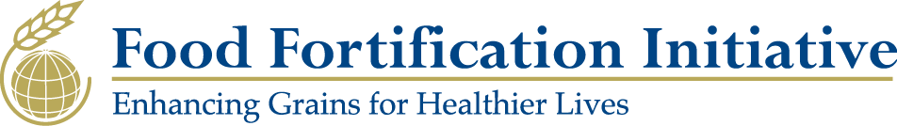
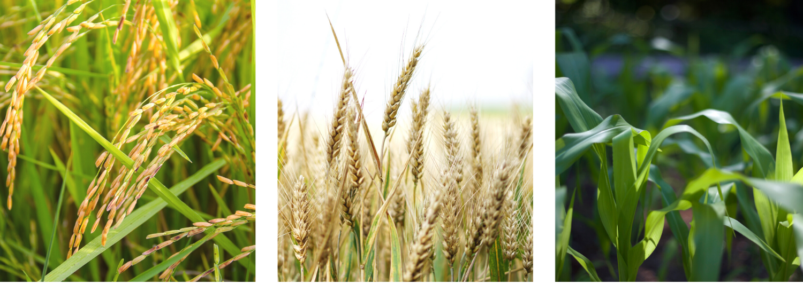
Mandatory cereal grain fortification: global status, best practices, and opportunities
Scott Montgomery
Director, Food Fortification Initiative
ICBD, 24 February 2020
Notes:
The Food Fortification Initiative (FFI) is a not for profit agency based at Emory University in Atlanta, GA. We work in close partnership with the CDC’s Birth Defects and Nutrition Division, the CDC Foundation, and the multitude of partners working in the fortification and nutrition sector (particularly, GAIN, WFP, NI, IGN, and UNICEF).
We are made up of a dynamic team of passionate professionals dedicated to combating malnutrition with staff in Africa, Asia-Pacific, and South Asia.
We are a unique initiative within the nutrition space. We are the only organization that focuses exclusively on fortifying cereal grains (wheat flour, maize flour, and rice) and we play a distinctive role bringing together partners working in fortification to ensure effective coordination and prevent duplicative efforts.

Slide 2
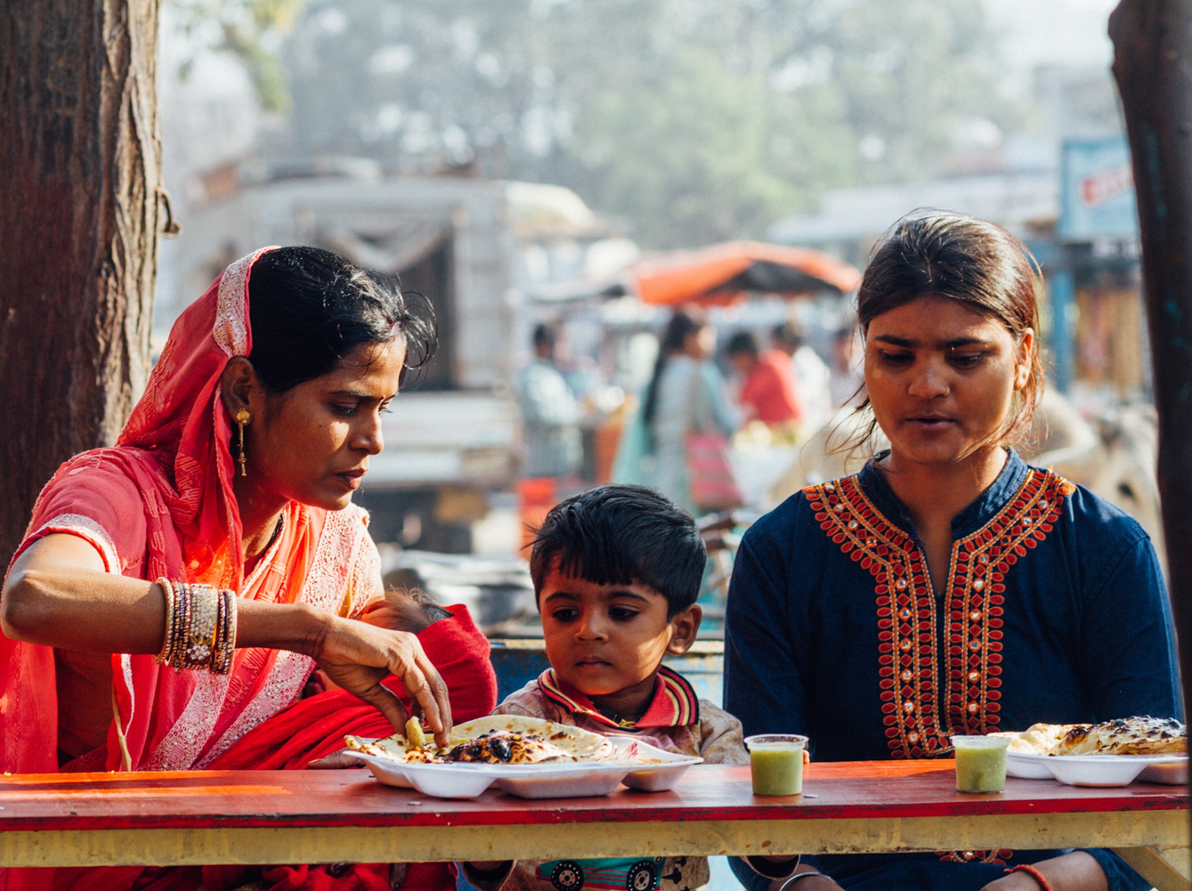
Mandatory cereal grain fortification 1. Global status 2. Best practices: FFI’s phased approach 3. Opportunities
Photo: Arjun Claire
Photo: Adam Cohn

Slide 3
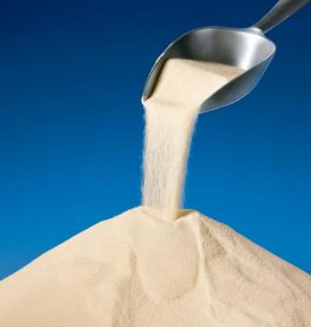
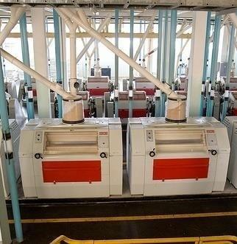
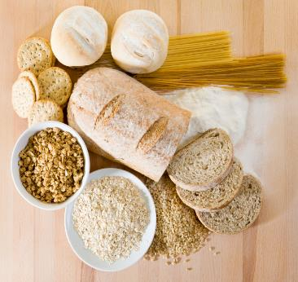
What is fortification?
Adding vitamins and minerals
during the milling process
to produce more nutritious foods
Photo from Mühlenchemie
Photo by David Snyder / CDC Foundation
Istockphoto
3
Notes:
As Vijaya noted, fortification is an effective way to increase the population’s folic acid intake and thereby prevent NTDs. Before we continue, I want to be clarify what I mean when I talk about fortification. To put it simply, fortification is adding vitamins and minerals during the milling process so that everyday foods are more nutritious. Note that I am not referring to biofortification or genetic modification.
The vitamins and minerals are added in parts per million; they have no effect on the final consumed foods’ taste, appearance, or baking characteristics.

Slide 4
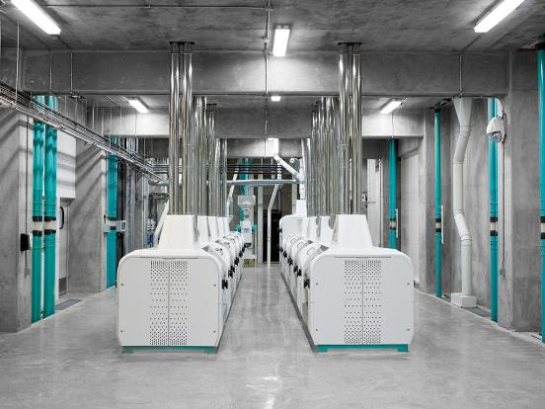
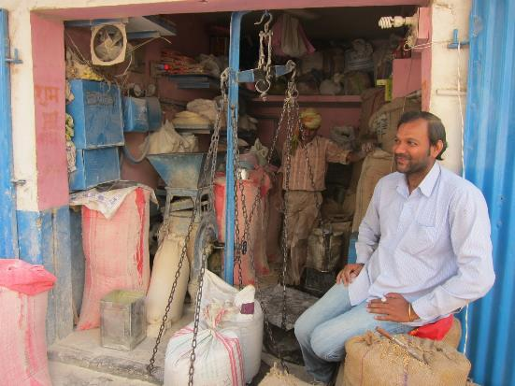
FFI focuses on industrially milled wheat flour, maize flour, and rice
Industrial mill
Village-type chakki mill
Photo: Bühler
Photo: David McKee
4
Notes:
While many foods can be fortified, our focus at FFI is fortification of wheat flour, maize flour and rice that is milled in industrial settings. That means mills like the ones on the left, not the right. If you are from Africa, you probably call these hammer mills.
The technology for fortification in industrial settings has been used for decades. It can be sustained through standard operating procedures, and costs are incorporated into operational expenses. In many countries, industrially milled grains reach nearly all the population.

Slide 5
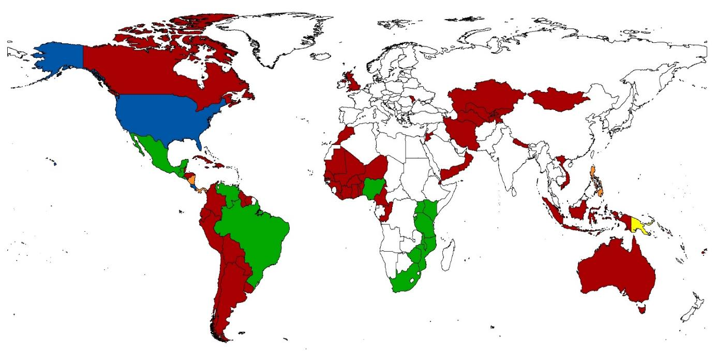
2020: 84 countries require folic acid in industrially milled wheat flour, maize flour, and/or rice
5
Notes:
Countries fortify one or more industrially milled cereal grain products to improve the nutrient intake of people in their target audience. This map reflects wheat flour, maize flour, and rice fortification legislation.
Now the 84 countries in blue require folic acid in their wheat flour, maize flour, and/or rice. Each country sets its standard for the amount to be added based on the population’s typical consumption of grain products. The amount added ranges from 0.4 to 5 parts per million.

Slide 6
Fortifying with folic acid leads to healthcare savings from preventing spina bifida
1:12
Chile
1:30
South Africa
1:48
United States
Llanos A, Hertrampf E, Cortes F, et. al. Health Policy. 2007 Oct;83(2-3):295-303
Sayed AR, Bourne D, Pattinson R, et. al. Birth Defects Res A Clin Mol Teratol. 2008 Apr;82(4):211–216
Grosse SD, Berry RJ, Mick Tilford J, et. al. Am J Prev Med. 2016 May;50(5 Suppl 1):S74-80. Epub 2016 Jan 11
6
Notes:
While the millers typically incur most of the expenses of fortification, the country benefits from reduced healthcare expenses when spina bifida is prevented.
Three countries have compared the costs of adding folic acid to flour with the costs of treating people with spina bifida. Each study showed significant net savings in healthcare expenses when spina bifida is prevented. In the private sector we often refer to this as payback or return on investment. In the US example, for every dollar spent on mandatory folic acid fortification, the healthcare savings were 48 times that investment. This refers to only the direct cost of fortification. Each example here is an incredible return on investment.

Slide 7
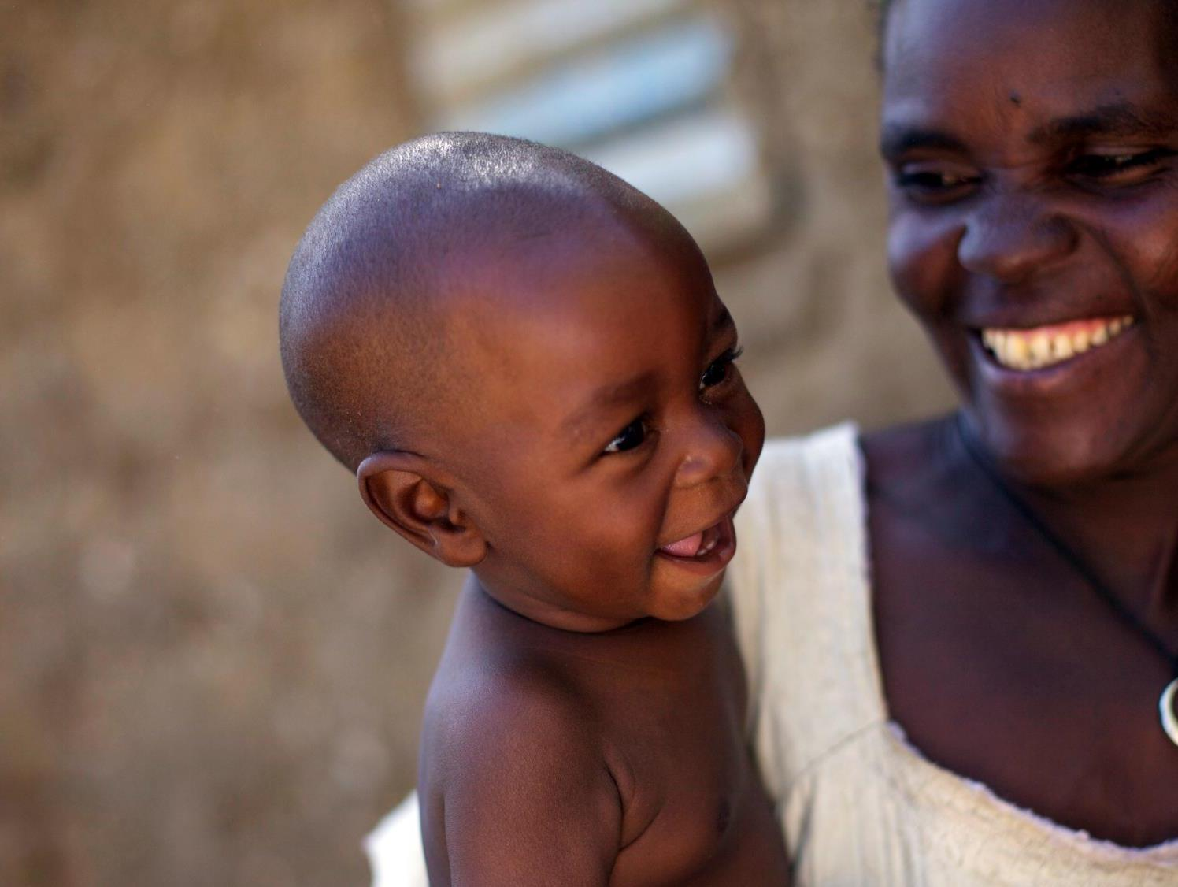
GLOBAL GAP
An additional 82% of birth defects of the brain and spine¹ and 34% of global anemia² could still be prevented through adequate intake of iron and folic acid.
¹ https://www.ncbi.nlm.nih.gov/pubmed/30070772
² https://www.ncbi.nlm.nih.gov/pubmed/30997493
Photo: Benedicte Kurzen
Notes:
But more needs to be done.
Over 2 billion people are affected by vitamin and mineral deficiencies. Vitamins and minerals used in fortification such as iron and folic acid prevent birth defects of the brain and spine as well as anemia caused by nutritional deficiencies.
We have the evidence we need, we know how to make people smarter, stronger, and healthier through fortification—we just need to mobilize the financial resources in a strategic and focused manner.
A key challenge: need for adequate standards

Slide 8
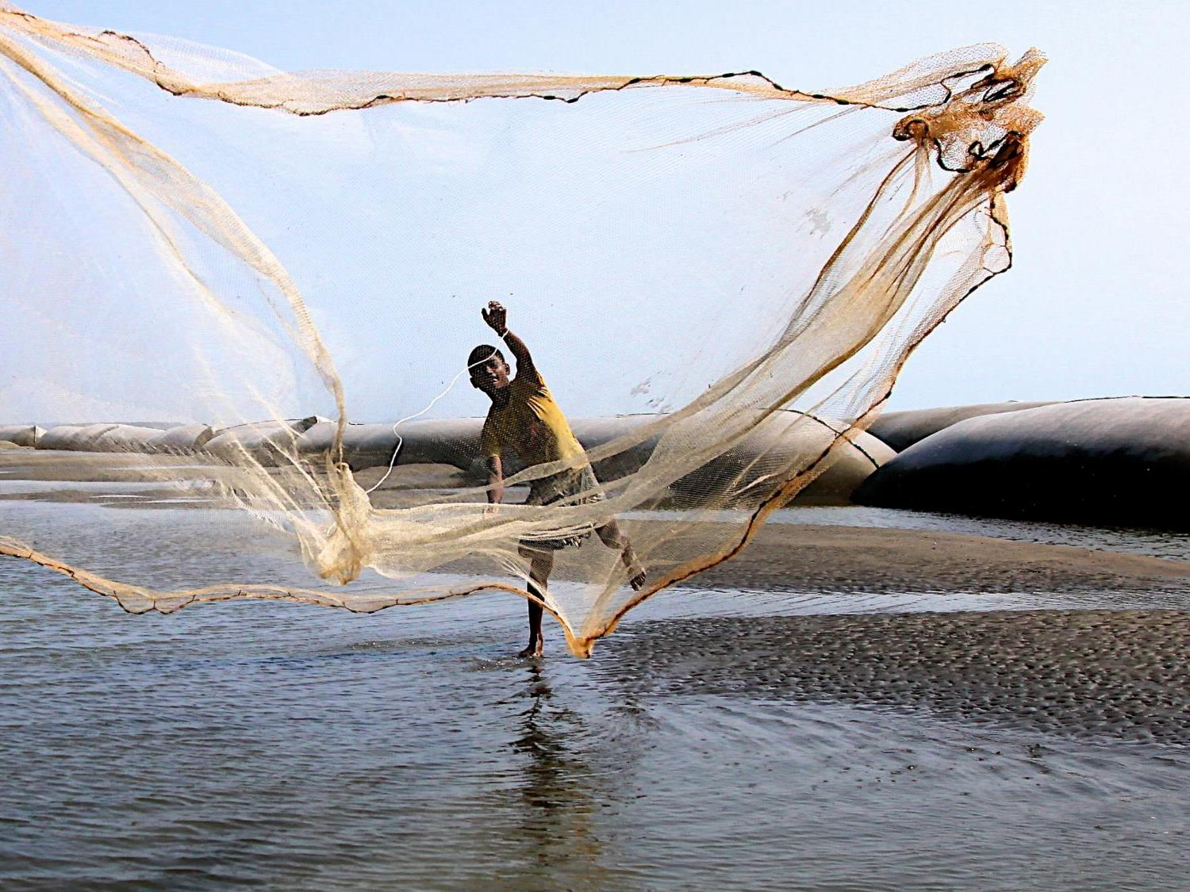
BEST PRACTICES FFI’s phased approach
Photo: Hasim Hayder
Notes:
Choose geographies, regions, states and provinces through rigorous research.
Why do we take this approach? Because of all the roadblocks that will happen along the way. There’s too much that is not in our control

Slide 9
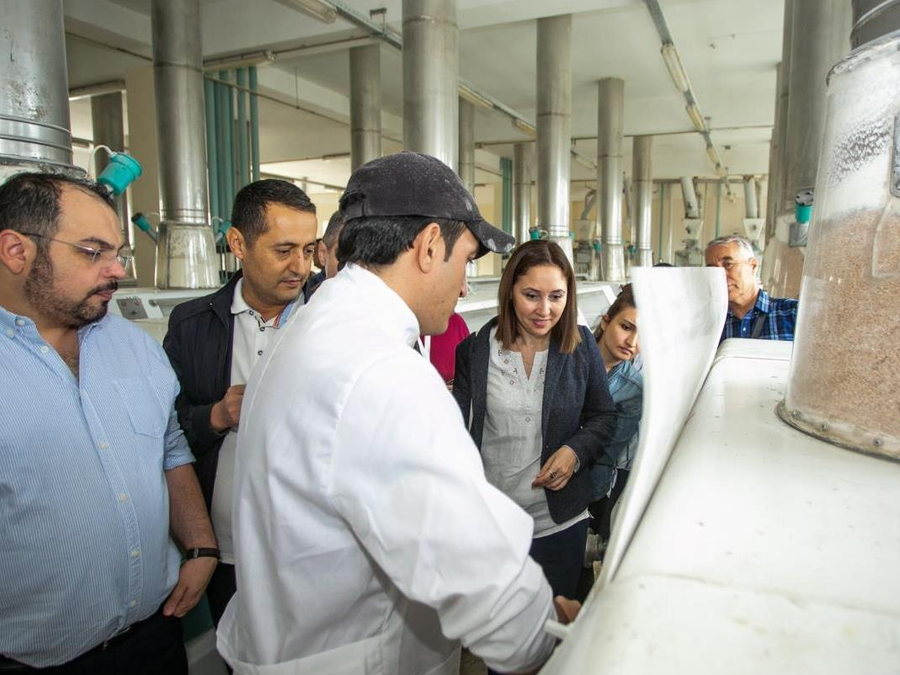
Data driven assessment
Our work starts with data and understanding the country context
We determine if a country or state has potential and demonstrated need for fortification using:
Consumption and milling analyses
Nutritional need assessments
Market analyses
Political readiness assessments
Current fortification reviews
Partner interviews

Slide 10

1. Explore 2. Champion 3. Design and development 4. Implement
Four strategic phases:
Photo: Aftab Uzzaman
Notes:
Explore:
Once a data-driven opportunity is determined:
Engage private sector
Engage birth defects groups, neurosurgeons, and consumers associations
Identify key challenges and opportunities
Identify a champion/champions within government
Map what it will take to move forward
Milestone: Permission and willingness of government to move to next phase
2. Champion
Conduct a thorough supply chain diagnostic
Assess industry structure including readiness and reach of mills
Assess monitoring structure and needs
Map the legislative process
Assess budgetary needs (initial investment by sector and annual recurring costs) to ensure commitment and sustainability
If necessary, conduct a cost-benefit analysis making the case for fortification’s impact on national health and economic indicators
Milestones:
Formal presentation to government to recommend effective staples and market channels based on diagnostic results
Government plan, permission, and support to move to the next phase
3. Design and development
Draft recommended standards
Identify miller, regulatory inspector, and laboratory training needs
Support premix procurement process
Engage the legislative process
Develop a communication and education strategy
Design a realistic monitoring framework
Design a surveillance system to capture coverage and impact
Milestone: Clear budget and implementation plan
4. Implement
Train millers on QA/QC practices
Train regulatory monitoring inspectors and lab staff; map agency responsibilities
Facilitate the passage of legislation
Develop a National Fortification Guidelines document and national logo, as necessary
Support collection, sharing, and acting upon monitoring data
Support collection of coverage and impact data via the surveillance system

Slide 11
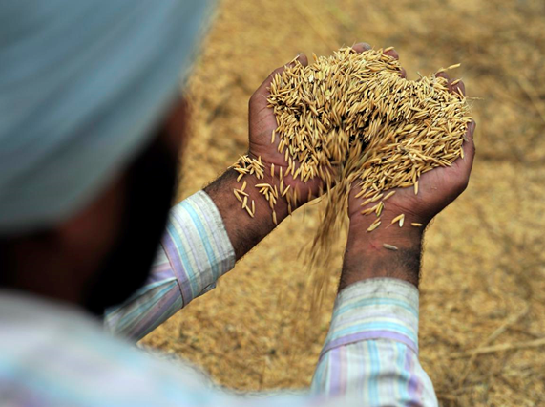
Legislation leads to high coverage
82%
Average percent of industrially milled wheat flour that is fortified in countries with legislation
15%
Average percent of industrially milled wheat flour that is fortified in countries without legislation
Food Fortification Initiative database
Photo: Neil Palmer
Notes:
At FFI we encourage countries to make fortification mandatory for several reasons. Mandatory fortification is our preference because it:
Helps ensure high coverage
Equalizes costs for millers
Establishes appropriate standards
Enables monitoring
For example. high coverage is rarely achieved without legislation. As you can see, the average percent of industrially milled wheat flour that is fortified in countries with legislation is much higher than the average percent that is fortified in countries without legislation.
The only places where voluntary fortification reaches country-wide coverage is in countries that only have one or two industrial mills and the mill managers fortify as part of their social corporate responsibility. This practice can be in jeopardy if the mill changes ownership or if an economic downturn causes the mill to cut costs.

Slide 12
High coverage leads to healthier lives
Folate and other nutrient deficiencies decreasing in Fiji
Percent of women aged 15–45 deficient before and after flour fortification, Fiji, N=869
Measurement | Percent deficient before, 2004 | Percent deficient after, 2010 | Cut offs used for deficiency in women¹
Serum folate | 8 | 1 | Serum folate <10 nmol/L
Iron | 23 | 8 | Serum ferritin <15 mg/L
Zinc | 39 | 0 | Serum zinc <10.1 mmol/L
In addition, anemia prevalence among
this group dropped from 40% to 28%.
Anemia defined as hemoglobin <12g/dL
Only 16.1% of the women had taken nutrient supplements in the six months prior to the survey
National Food and Nutrition Centre 2010 ffinetwork.org/monitor/Documents/Fiji.pdf
¹ World Health Organization apps.who.int/iris/bitstream/10665/161988/1/9789241549042_eng.pdf
12
Notes:
High coverage is important because we want as many people as possible to benefit from the proven benefits of fortification. Effectively fortifying with folic acid prevents NTDs. I want to show you two examples of countries that looked at folate levels before and after fortification.
Fiji studied the results of wheat flour fortification using mean blood serum levels and World Health Organization cutoffs for deficiency among women. During the study period, no other nutrition intervention was implemented.
Notice the improvements in iron, and zinc deficiency and percent of women with anemia as well as the reduction in percent of women with folate deficiency. We are focused on folic acid today, but remember that flour can be fortified with multiple nutrients. It is one intervention with multiple outcomes.

Slide 13
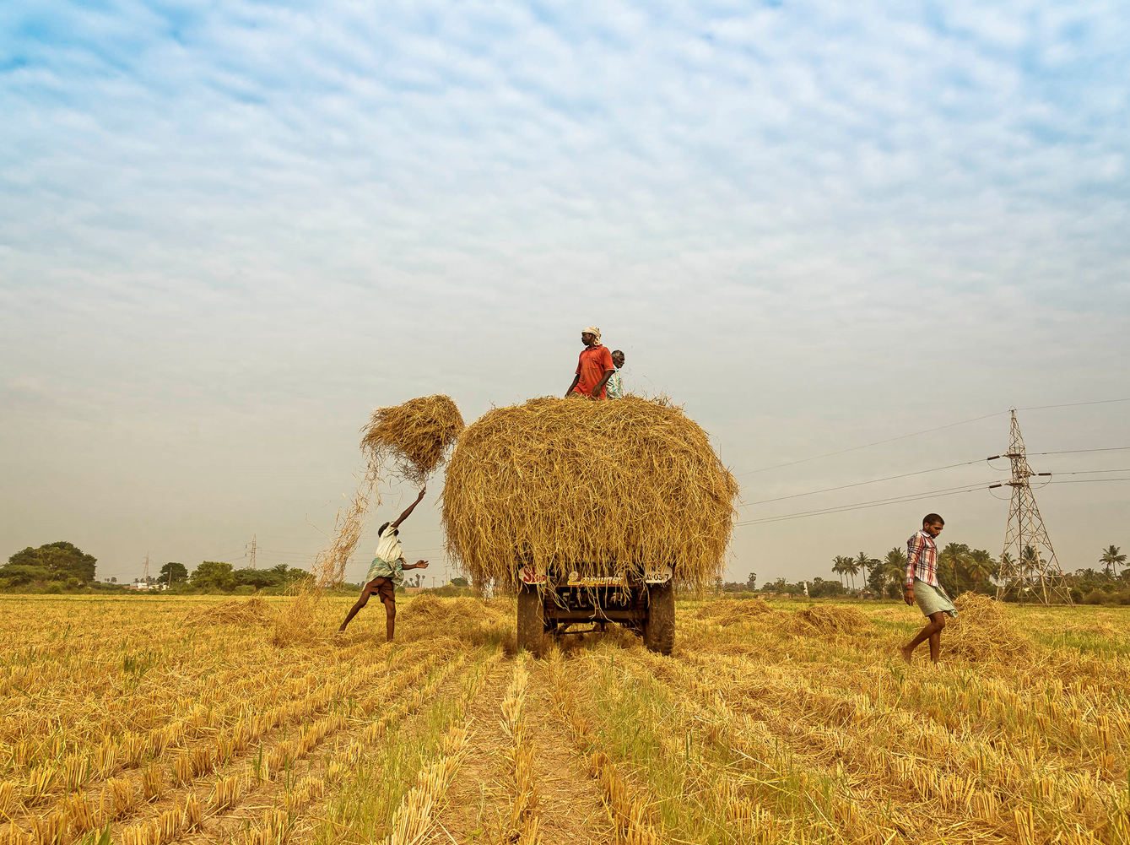
FORTIFICATION
Opportunities
in Asia
Photo: Muthuraman/Flickr

Slide 14
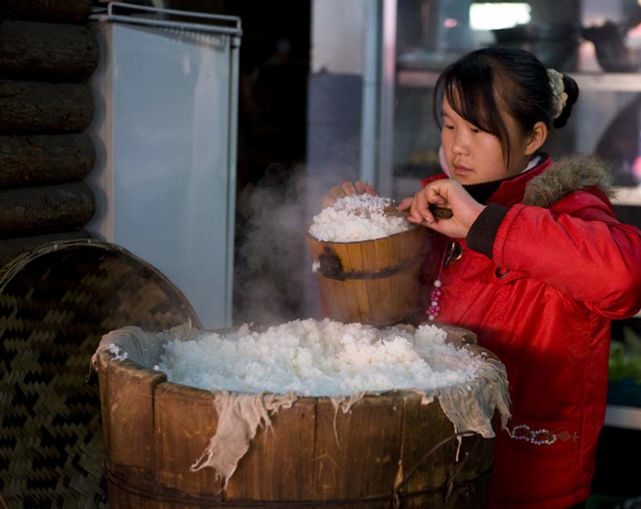
ASIA-PACIFIC
Opportunities
FFI is supporting 7 countries in Asia-Pacific through 2021.
EXPLORE | CHAMPION | DESIGN | IMPLEMENT
Malaysia | Indonesia | Mongolia | Solomon Islands
Papua New Guinea | Philippines |  | Viet Nam
Photo: Steve Evans

Slide 15
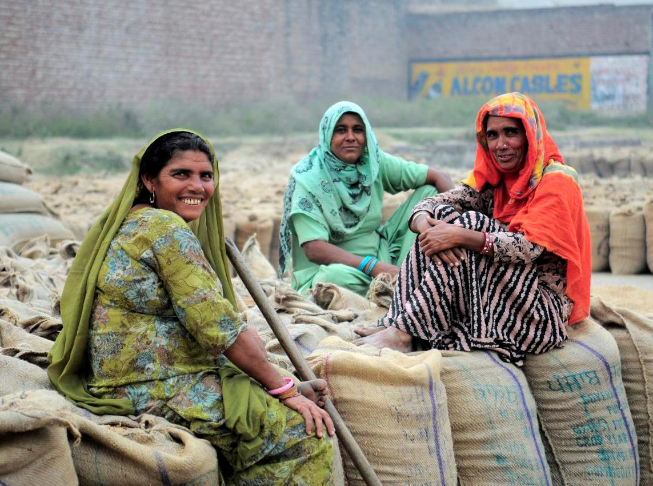
SOUTH ASIA
Opportunities
FFI supports the scale-up of fortified atta in the Indian state of Haryana’s social safety net programs. Pending additional funding, FFI will prioritize support to Sri Lanka and 17 additional states in India.
EXPLORE |  | CHAMPION | DESIGN | IMPLEMENT
Andhra Pradesh | Kerala | Orissa | Sri Lanka | Haryana
Bihar | Madhya Pradesh
Chhattisgarh | Maharashtra
Gujarat | Punjab
Himachal Pradesh | Rajasthan
Jammu & Kashmir | Tamil Nadu
Jharkhand | Uttar Pradesh
Karnataka | West Bengal
Photo: NeilPalmer/CIAT
Notes:
The Food Fortification Initiative (FFI) has identified 18 states in India with potential for fortified rice or wheat flour in various market channels. Wheat flour fortification in the government’s Public Distribution System (PDS) has successfully moved forward in the state of Haryana. FFI has provided technical support in Haryana by conducting a wheat supply chain analysis, calculating the costs for the government to supply fortified wheat flour in the PDS system, and ensuring consumer acceptance of the fortified product.
For the remaining 17 states, FFI proposes examining the current political environment to determine which states have leadership willing to support grain fortification with at least iron, vitamin B12, and folic acid. For the identified states, FFI would conduct an assessment to include:
Industry capacity to fortify flour and/or rice using published reports and interviews with millers
Current wheat flour and rice consumption patterns based on existing survey data
Potential distribution channels such as the PDS and open market, and the reach of each distribution channel
Next, FFI would present results of this assessment to state leaders and, building on the successful Haryana model, collaboratively develop practical, operational plans to fortify grains in each state. Activities would include:
Promote mandatory fortification so that costs and health benefits are shared equally
Create awareness about nutritional deficiencies, their consequences, and benefits of fortification
Generate commitment among influential multi-sector leaders to support fortification
Train millers to fortify their wheat flour and rice according to national standards Develop sustainable procedures for internal and external monitoring to ensure compliance with India’s fortification standards
Share the strategy with other nutrition groups in India to avoid duplication of efforts
FFI’s vision is for mandatory, sustainable grain fortification to be implemented and monitored in all 18 states.

Slide 16
