Slide 1
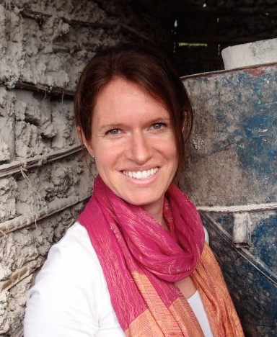
Laura Rowe
Deputy Director, FFI
April 2021
Notes:
Good afternoon. My name is Laura Rowe and I am the Deputy Director of the Food Fortification Initiative. I am grateful to be able to join you this afternoon, albeit remotely, for this important training.

Slide 2
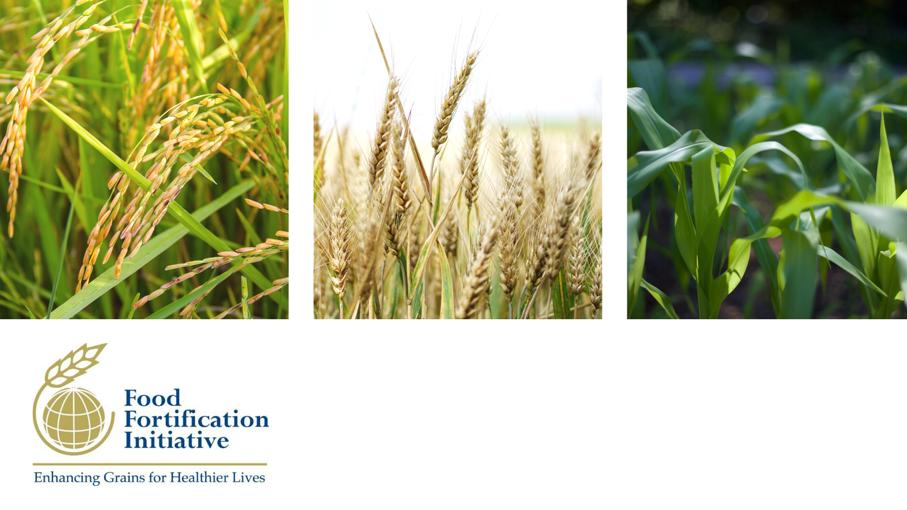
Introduction to the Food Fortification Initiative (FFI)
April 2021
Notes:
I will be giving a brief presentation on who we are at FFI and what we do.
FFI is a not for profit agency based at Emory University in Atlanta, GA that provides technical assistance to governments, millers, and civil society in the design and implementation of food fortification programs. We work in close partnership with the Centers for Disease Control (CDC) and other partners working in the fortification and nutrition sectors such as GAIN, UNICEF, WFP, etc.
FFI is made up of a dynamic team…In total, we are 13 staff members based in the US, Africa, Asia, and the South Pacific. Together we have expertise in milling, nutrition, program monitoring, and communications.
As the only organization that focuses exclusively on fortifying cereal grains (wheat flour, maize flour, and rice), FFI plays a distinctive role bringing together partners working in fortification to ensure effective coordination and prevent duplicative efforts.

Slide 3
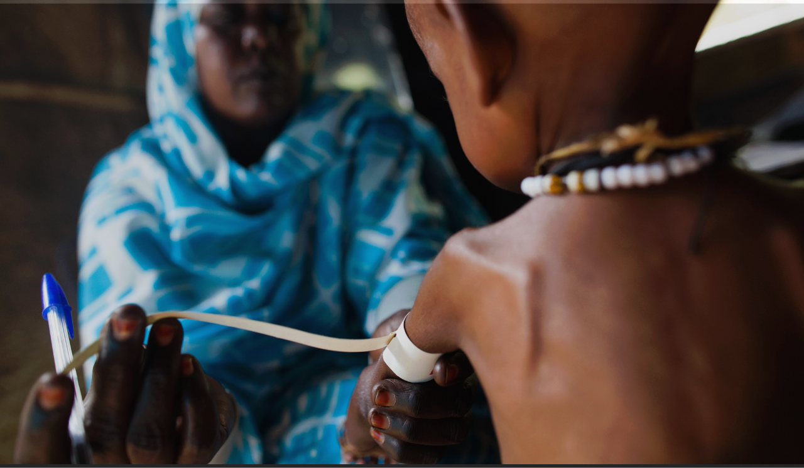
WHAT WE DO We fight malnutrition
Photo: Albert González Farran
Notes:
We are committed to combating malnutrition.

Slide 4

The Challenge
2 billion
People worldwide suffer the effects of micronutrient malnutrition.
1.6 billion
People affected by iron deficiency anemia.
250 million
Women of reproductive age are affected by iron deficiency anemia, doubling their risk for maternal death.
75%
Of children born with brain and spinal birth defects, die before their fifth birthday.
70%
Of these deaths are preventable with sufficient maternal folate intake
Von Grebmer et al, 2014
Daru et al, 2018
Blencowe et al, 2018
Petry et al, 2016
Photo: Albert González Farran
Notes:
And we are faced with a fairly significant challenge. Vitamin and mineral deficiencies are a form of malnutrition that affects over 2 billion people worldwide stunting growth and learning, weakening immune systems, and contributing to the deaths of more than a million children per year. ¹
Micronutrient malnutrition can result in several serious challenges.
We know that 1.6 billion people are affected by IDA.
Nearly 250 million women of reproductive age are affected by iron deficiency anemia³ and that pregnant women with severe anemia are twice as likely to die during or shortly after pregnancy than non-anemic women.²
Anencephaly and spina bifida are birth defects of the brain and spine that can be prevented by consuming enough folic acid. About 75% of children born with brain and spinal birth defects die before their fifth birthday. ⁴
And we know that about 70% of these deaths are preventable with sufficient maternal folate intake.
Fortification has the power to eliminate these effects of micronutrient deficiency.
In fact, it already is--research published using FFI data credited fortification with preventing 50,270 brain and spine birth defects globally in one year for an average of 137 healthier babies a day.⁵
Sources:
¹ von Grebmer, K., et al. 2014 Global health index: the challenge of hidden hunger. Welthungerhilfe, International Food Policy Research Institute, and Concern Worldwide. 2014.
² Daru, J., et al. Risk of maternal mortality in women with severe anemia during pregnancy and postpartum: a multilevel analysis. The Lancet Global Health. 2018.
³ World Health Organization. The global prevalence of anemia in 2011. 2015.
⁴ Blencowe, H., et al. Estimates of global and regional prevalence of neural tube defects for 2015: a systematic analysis. Annals of the New York Academy of Sciences. 2018.
⁵ Kancherla, V., et al. A 2017 global update on folic acid‐preventable spina bifida and anencephaly. Birth Defects Research Part A: Clinical and Molecular Teratology. 2018.

Slide 5
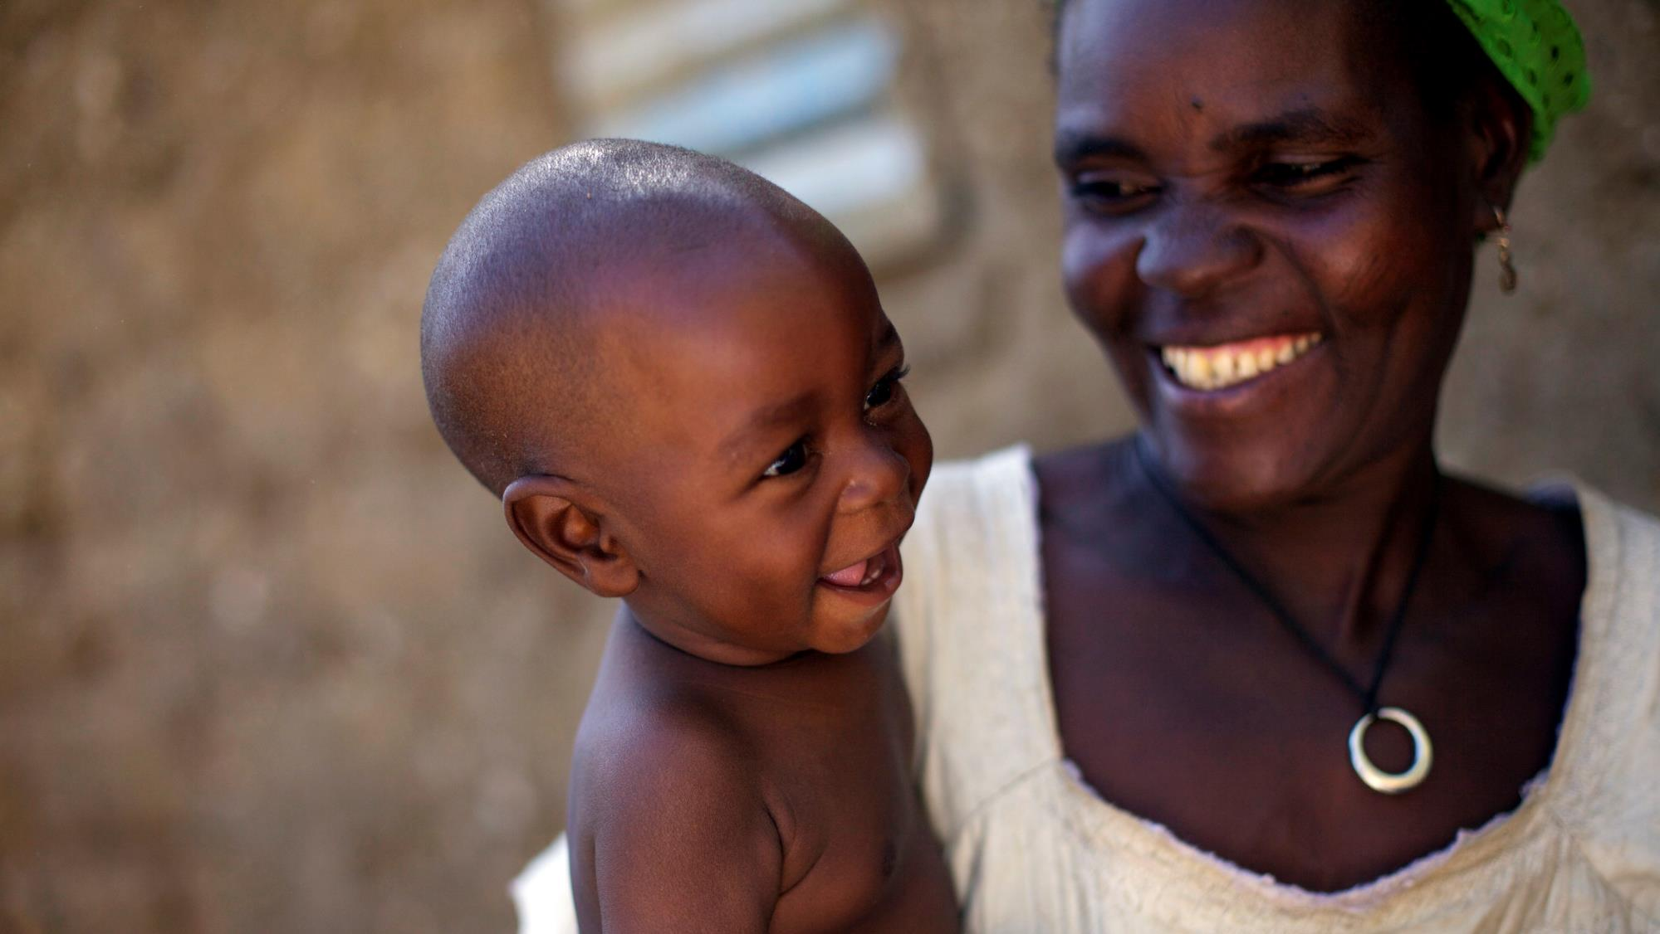
An additional 82% of
birth defects of the
brain and spine¹
and 34% of global
anemia cases²
could still be prevented through adequate
intake of iron and
folic acid.
The global gap
¹ https://www.ncbi.nlm.nih.gov/pubmed/30070772
² https://www.ncbi.nlm.nih.gov/pubmed/30997493
Photo: Benedicte Kurzen
Notes:
Yet there is still more to be done.
An additional 82% of birth defects of the brain and spine and 34% of global anemia cases could still be prevented through adequate intake of iron and folic acid.
At FFI, our mission is to close this global gap.

Slide 6
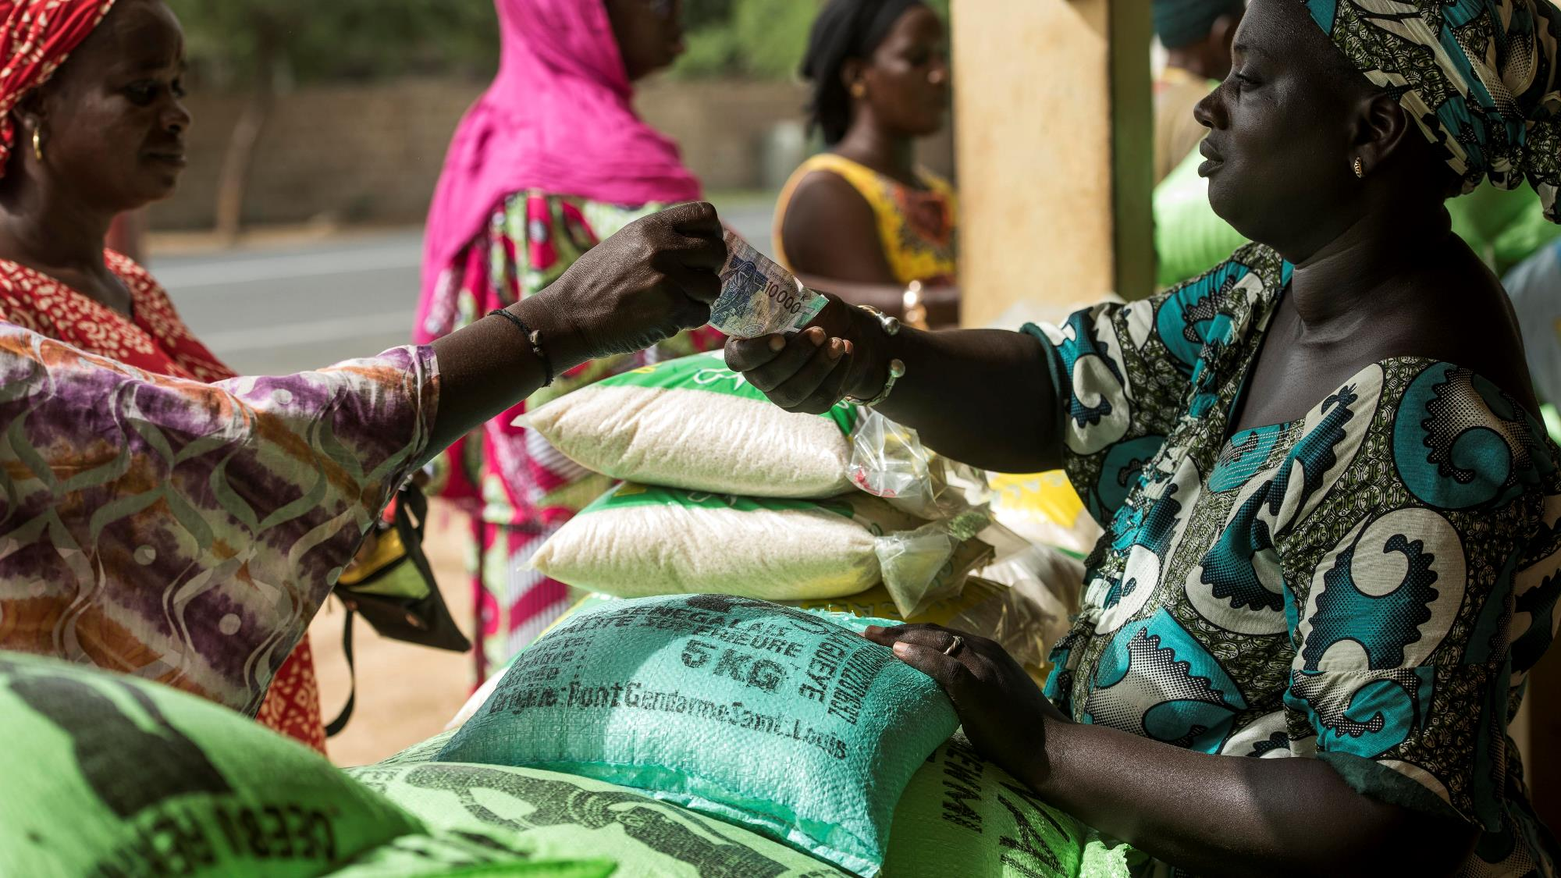
Fortification is one of the most cost-effective development investments that exist. - Copenhagen Consensus
Photo: Xaume Olleros/RTI
Notes:
There are numerous ways of getting essential vitamins and minerals to individuals and populations in need by improving access to healthy foods, improving the quality of grown and / or purchased foods, and by directly providing the missing nutrients in tablet or sachet form. And there are many interventions that may need to happen concurrently with the provision of such nutrients (e.g. improved water, sanitation, and hygiene; appropriate breastfeeding and complementary feeding practices; infection control, to name a few). There is no single magic bullet solution.
However, Top economists have declared fortification to be one of the most cost-effective development investments that exist today. As part of broad national programs to reduce chronic undernutrition, fortification can save national economies an estimated 2-3 percent of gross domestic product per year
Fortification is a unique prevention strategy because it does not rely on the health system to be carried out but instead on the private sector: food producers. And consumers do not have to do anything different – they just keep eating foods they already purchase and consume. So there is no behavior change that is required.
-----------------
Cost of vitamins and minerals to add to 1 metric ton of flour or rice are:
Wheat Flour:
Average of US$ 3 to fortify with iron, folic acid, and other B vitamins
Maize Flour:
Average of US$ 4 to fortify with iron, zinc, vitamin A, folic acid, and other B vitamins
Rice:
US$ 6 to US$ 20 to fortify with iron, zinc, vitamin A, folic acid, and other B vitamins
Source:
Walters D, Kakietek J, Eberwein JD, Shekar M. An Investment Framework for Meeting the Global Nutrition Target for Anemia.

Slide 7
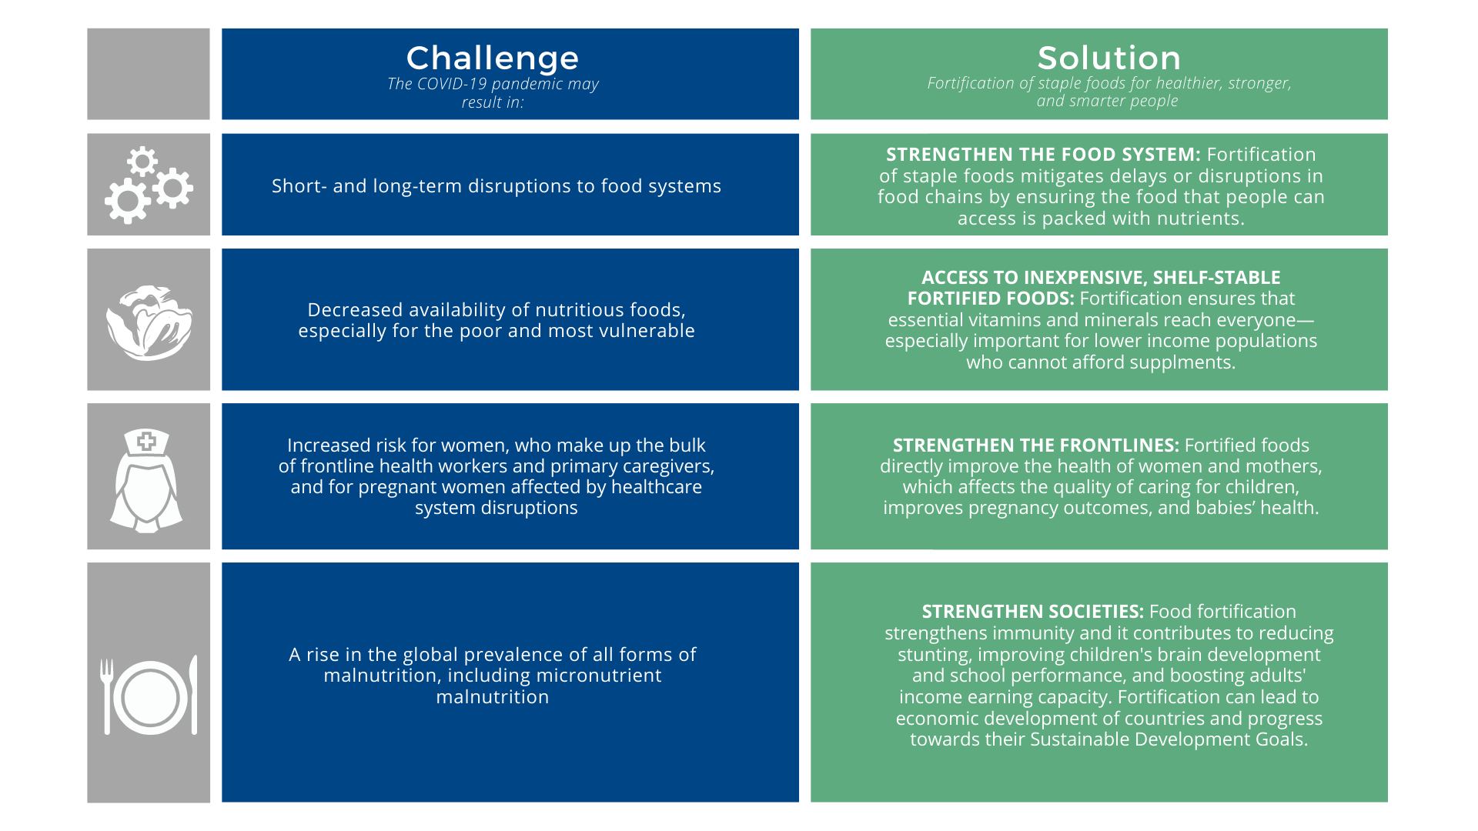
COVID-19 and Fortification
Notes:
And today, we know that fortification is a key intervention to fight Covid-19 and the hunger that results from the disruptions in food systems and decreased availability of nutritious foods.
This slide shows you the challenge that is posed by COVID-19 and the solution that fortification provides for that particular challenge.
In short, we know that the frontline of every country’s health system are the immune systems of its people. We know that micronutrients may influence the susceptibility of a person to infectious diseases and the course and outcome of such diseases. Good nutrition helps boost the immune system, lowers the risk of becoming critically ill with infectious diseases, and supports faster recovery when infected. While more data needs to become available on the role of nutrition to the severity of COVID-19, the role of micronutrients to the optimal function of immune systems is well established.

Slide 8
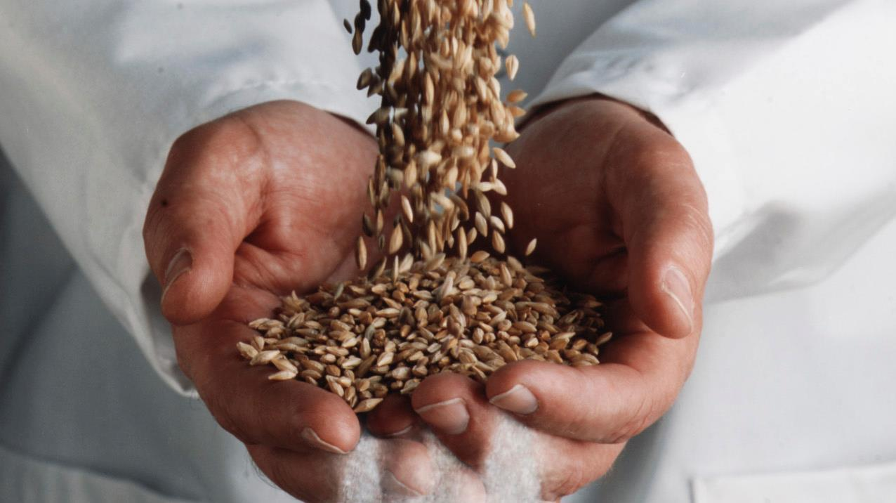
HOW WE WORK We support and empower locally
Notes:
So how does FFI ensure countries and governments have the necessary knowledge and tools to access whether fortification is needed and then how to go about putting such a program in place?
Per the request of governments, we provide targeted technical assistance to millers, governments, and civil society actors in the planning, implementation, and monitoring of national food fortification programs. We work in countries where coverage of cereal grains is high and where fortification can effectively fill a nutritional gap. We provide on-the-ground support to policy makers, food producers, regulatory staff, and consumer organizations to ensure all necessary stakeholders are included in the process from the very beginning.

Slide 9
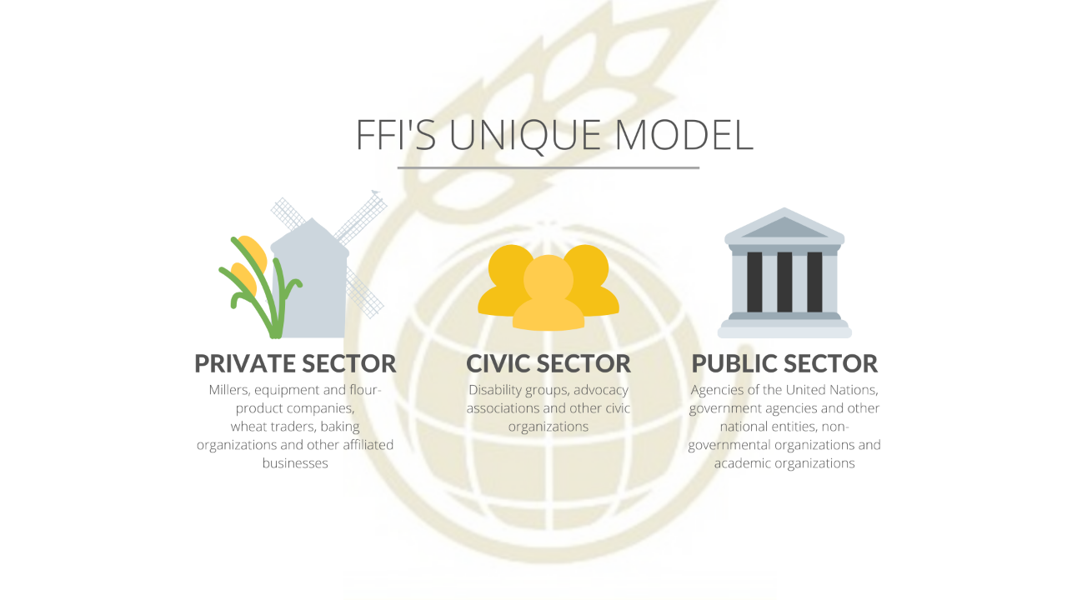
Notes:
We use a unique model that includes collaboration and coordination with private, civic, and public sectors.
FFI does not own any flour or rice mills, so we cannot actually fortify any grain. Consequently, we must rely on the private sector which owns the mills and distributes the flour and rice. The private sector is also a key part of monitoring as they perform quality assurance and quality control checks. The civic sector is involved in championing the cause and sometimes in monitoring the program. Finally, the public sector is involved in setting appropriate standards for the type of nutrients and levels of nutrients to be included in each food and is generally charged with external monitoring.

Slide 10
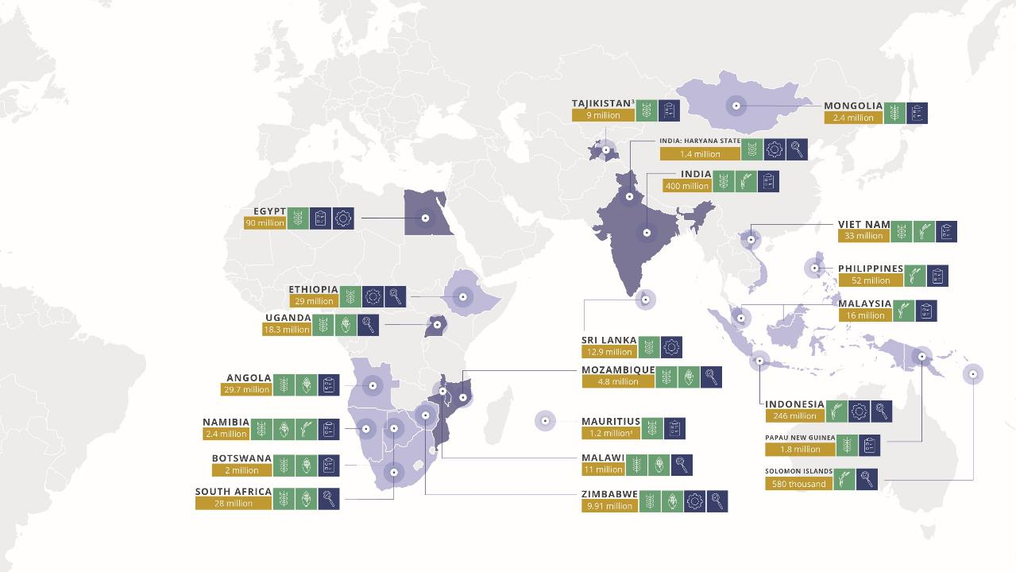
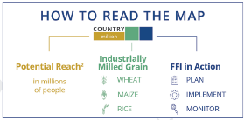
FFI around the world: 2020
Notes:
In 2020, we worked closely with our partners in 21 countries across four regions: Africa, Asia-Pacific, Europe, and India, improving nutrition for 580 million people—13% of the world’s population.
Globally, we provide evidence-based resources such as research published in peer-reviewed journals; tool kits on flour milling, fortification communications/advocacy, and regulator monitoring, to name a few; and we track and share global progress (see our website for a status report on every country in the world and their current fortification efforts).

Slide 11
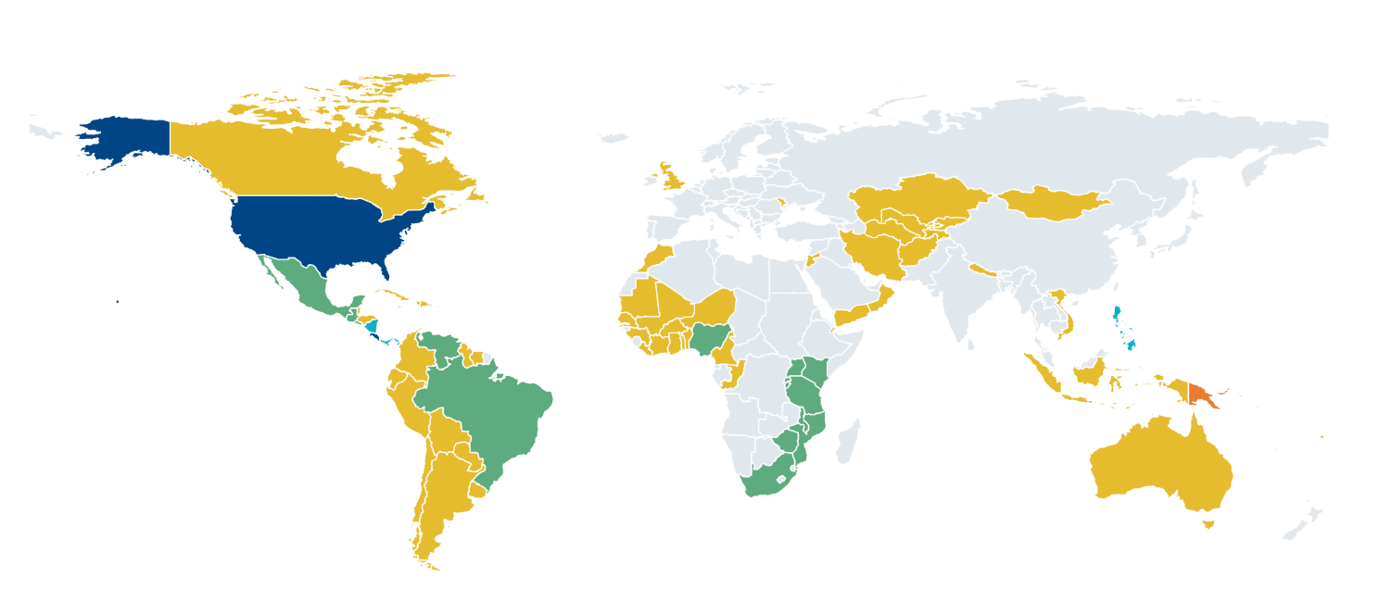
86 countries with legislation to fortify industrially milled flour and/or rice
Legislation in 85 countries mandates fortification of wheat flour alone or in combination with maize flour and/or rice.
One country (Papua New Guinea) has legislation to only fortify rice.
 | Wheat flour alone – 64 countries |  |  | Wheat flour and rice – 4 countries (Nicaragua, Panama, Philippines, Solomon Islands)
 | Rice alone – 1 country (Papua New Guinea) |  |  | Wheat flour, maize flour, and rice – 2 countries (Costa Rica and the United States)
 | Wheat flour and maize flour –15 countries |  |  | No mandatory fortification legislation or data not available
Legislation has effect of mandating grain fortification with at least iron or folic acid. Legislation status from the Food Fortification Initiative (www.FFInetwork.org) July 2020.
Notes:
This is one of FFI’s most cited figure: the number of countries with legislation to fortify industrially milled wheat flour, maize flour and rice.
Currently, that number is 86. The different colors on this map reflect the different combinations of grains that are mandated to be fortified. For example, the yellow color represents the 64 countries that only mandate the fortification of wheat flour. Whereas light blue reflects the four countries that mandate the fortification of wheat flour and rice.
We look forward to this adding Egypt as the 87th country this year!

Slide 12
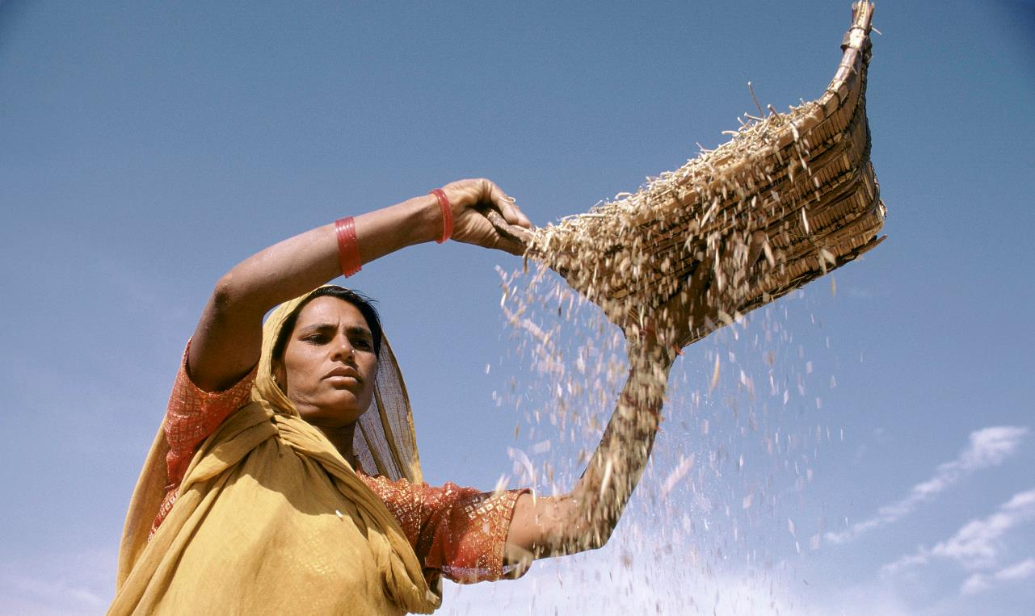
UNMET POTENTIAL
Most of the world’s industrially milled grains are not yet fortified.
 | WHEAT FLOUR | MAIZE FLOUR | RICE
 | million metric tons | million metric tons | million metric tons
Available for human consumption | 355 | 90 | 377
Industrially milled | 282 | 32 | 210
Industrially milled and fortified | 90 | 17 | 2
% industrially milled and fortified | 30% | 30% | 1%
Photo: Ray Witlin
Notes:
Despite recent strides, however, billions of people do not receive enough vitamins and minerals to reach their full potential. More needs to be done.
Every year, FFI assesses the progress of our programs and of global fortification efforts by calculating the percentage of grain that is industrially milled and fortified in every country. In 2020, we found that progress has been made, but that there’s a large part of the world that still doesn’t have access to fortified foods.
The first line in this table is the amount of cereal grains available for human consumption.
The second line is the amount of that cereal grains that is industrially milled.
The third line is the metric tons of industrially milled grains that are fortified.
Source: Food and Agriculture Organization of the United Nations (FAO) for 2013.
FFI calculations. Food Fortification Initiative. 2019 Annual Report. FFI: Atlanta, USA 2020.

Slide 13

FFI looks forward to working with the the millers, government, and civil society in Egypt to improve the lives of 90 million people (90% of the population!)
Photo: Benedicte Kurzen
Notes:
We are confident that this training will put Egypt on the path to ensuring most of it’s population have access to flour and bread that contains critically needed nutrients and FFI looks forward to working with the millers and the government and civil society actors in Egypt to improve the lives of 90 million people (90% of the Egyptian population)!

Slide 14

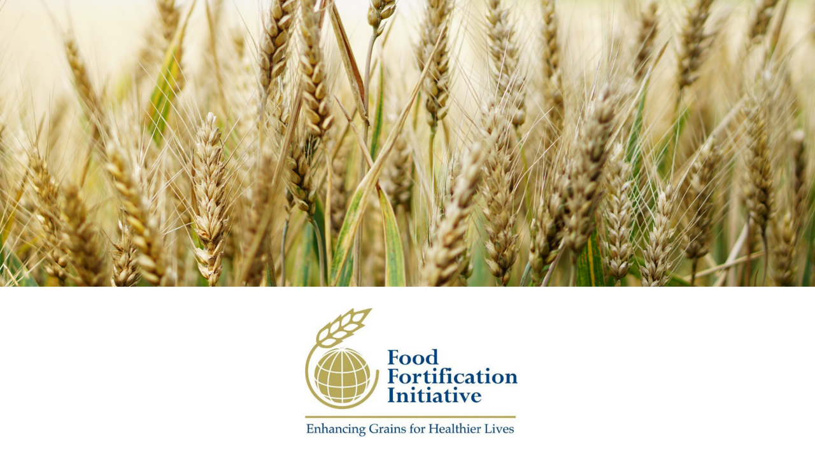
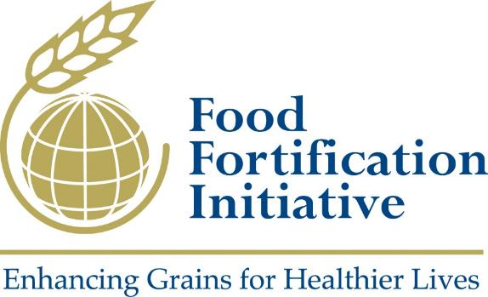
Notes:
Thank you!

