Slide 1
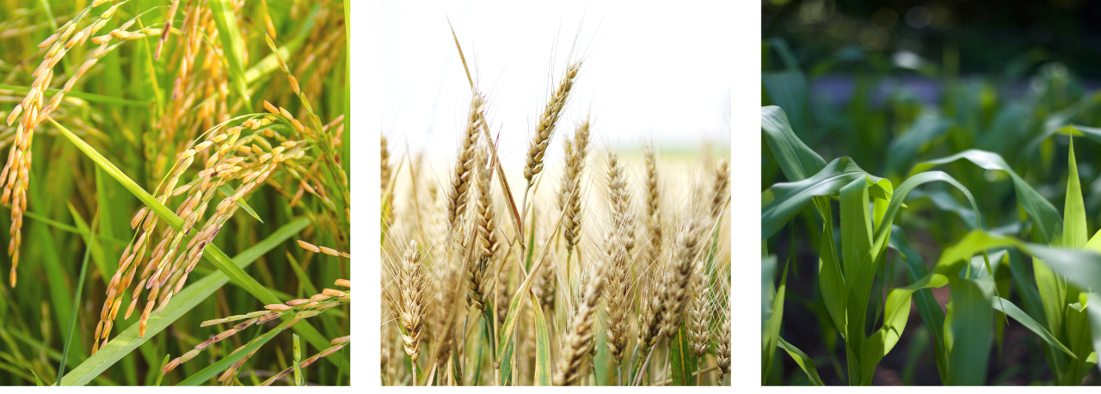
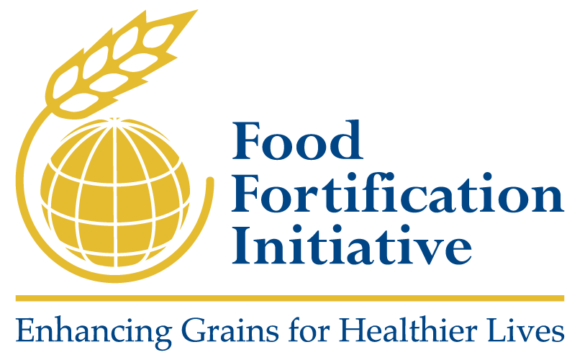
Building a Healthier Future Through Large-Scale Food Fortification
Scott Montgomery, Director, FFI
Digital Millers Conference,
September 2021
Notes:
The Food Fortification Initiative (FFI) is a not for profit agency based at Emory University in Atlanta, GA. We champion effective grain fortification so people have the nutrition they need to be smarter, stronger, and healthier.

Slide 2
About FFI
Expertise
Rigor
Focus
Uses in-house expertise to apply a data-driven approach to program planning, implementation, and monitoring
Operates through a unique model, bringing together voices from the public, private, and civic sectors
Conducts supply chain analyses for any given grain to discover and act on opportunities to advance fortification
Documents and publishes up to 196 countries’ annual progress toward successful cereal grain fortification
Focuses exclusively on large-scale fortification of the three most consumed grains: wheat flour, maize flour, and rice
Disciplined people
Disciplined thought
Disciplined action
Notes:
We are a unique initiative within the nutrition space:
Expertise: FFI has in-house leadership and technical expertise to apply a data-driven approach to program planning, implementation, and monitoring.
We are made up of a dynamic team of 13 passionate professionals dedicated to combating malnutrition with staff in Africa, Asia, and the South Pacific. Our staff not only helps partners plan, implement, and monitor fortification using evidence-based methods; they also help generate the evidence and data-driven methods for fortification programs.
Rigor:
FFI operates through a unique model, bringing together voices from the public, private, and civic sectors through FFI's Executive Management Team and FFI’s technical assistance to make sustainable change.
FFI conducts supply chain analyses for any given grain to discover and act on opportunities to advance fortification.
FFI documents and publishes up to 196 countries’ annual potential and progress toward successful cereal grain fortification.
Focus: We know what we are deeply passionate about, we know what we can be the best in the world at, and we know what the key to a stronger, smarter, and healthier future is. FFI is the only global group that focuses exclusively on large-scale fortification of the three most consumed grains: wheat flour, maize flour, and rice.
Source: Adapted from the Good to Great model by Jim Collins

Slide 3
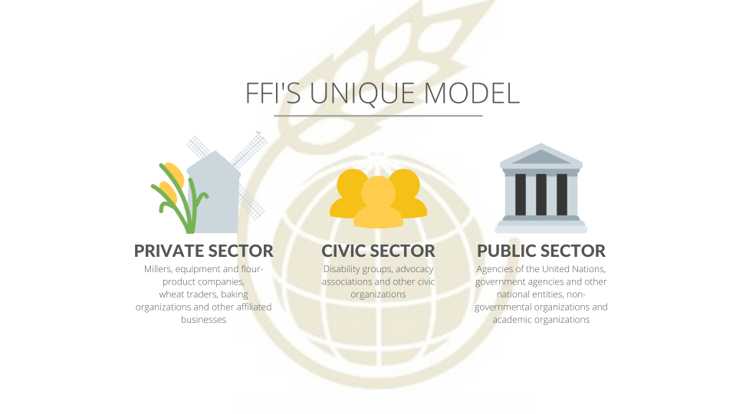
Notes:
FFI operates through a unique model, bringing together voices from the public, private, and civic sectors in our management and in our technical assistance to make sustainable change.
FFI does not own any flour or rice mills, so we cannot actually fortify any grain. Consequently we must rely on the private sector which owns the mills and distributes the flour and rice. The private sector is also a key part of monitoring as they perform quality assurance and quality control checks. The public sector is involved in setting appropriate standards for the type of nutrients and levels of nutrients to be included in each food. The public sector is generally charged with external monitoring. For fortification, the civic sector is involved primarily in advocacy.
The FFI role in all this is to prompt partners to take action to fortify grain products.
FFI is managed by an Executive Management Team that includes large multinational agribusiness companies like Cargill and key partners in the fortification space like the Global Alliance for Improved Nutrition.
Since FFI was formed in 2002, we have had a uniquely strong link to the United States’ Centers for Disease Control and Prevention and UN agencies such as the World Health Organization and UNICEF.

Slide 4




How FFI works
Explore and engage
PLAN
Data-driven opportunity
Monitor for compliance and impact
Map the context
IMPLEMENT
Design and develop
MONITOR
Notes:
FFI helps countries plan, implement through technical assistance, and monitor fortification programs. We do this through our four-stage phased approach, which articulates key milestones to be achieved before moving to the next phase.

Slide 5
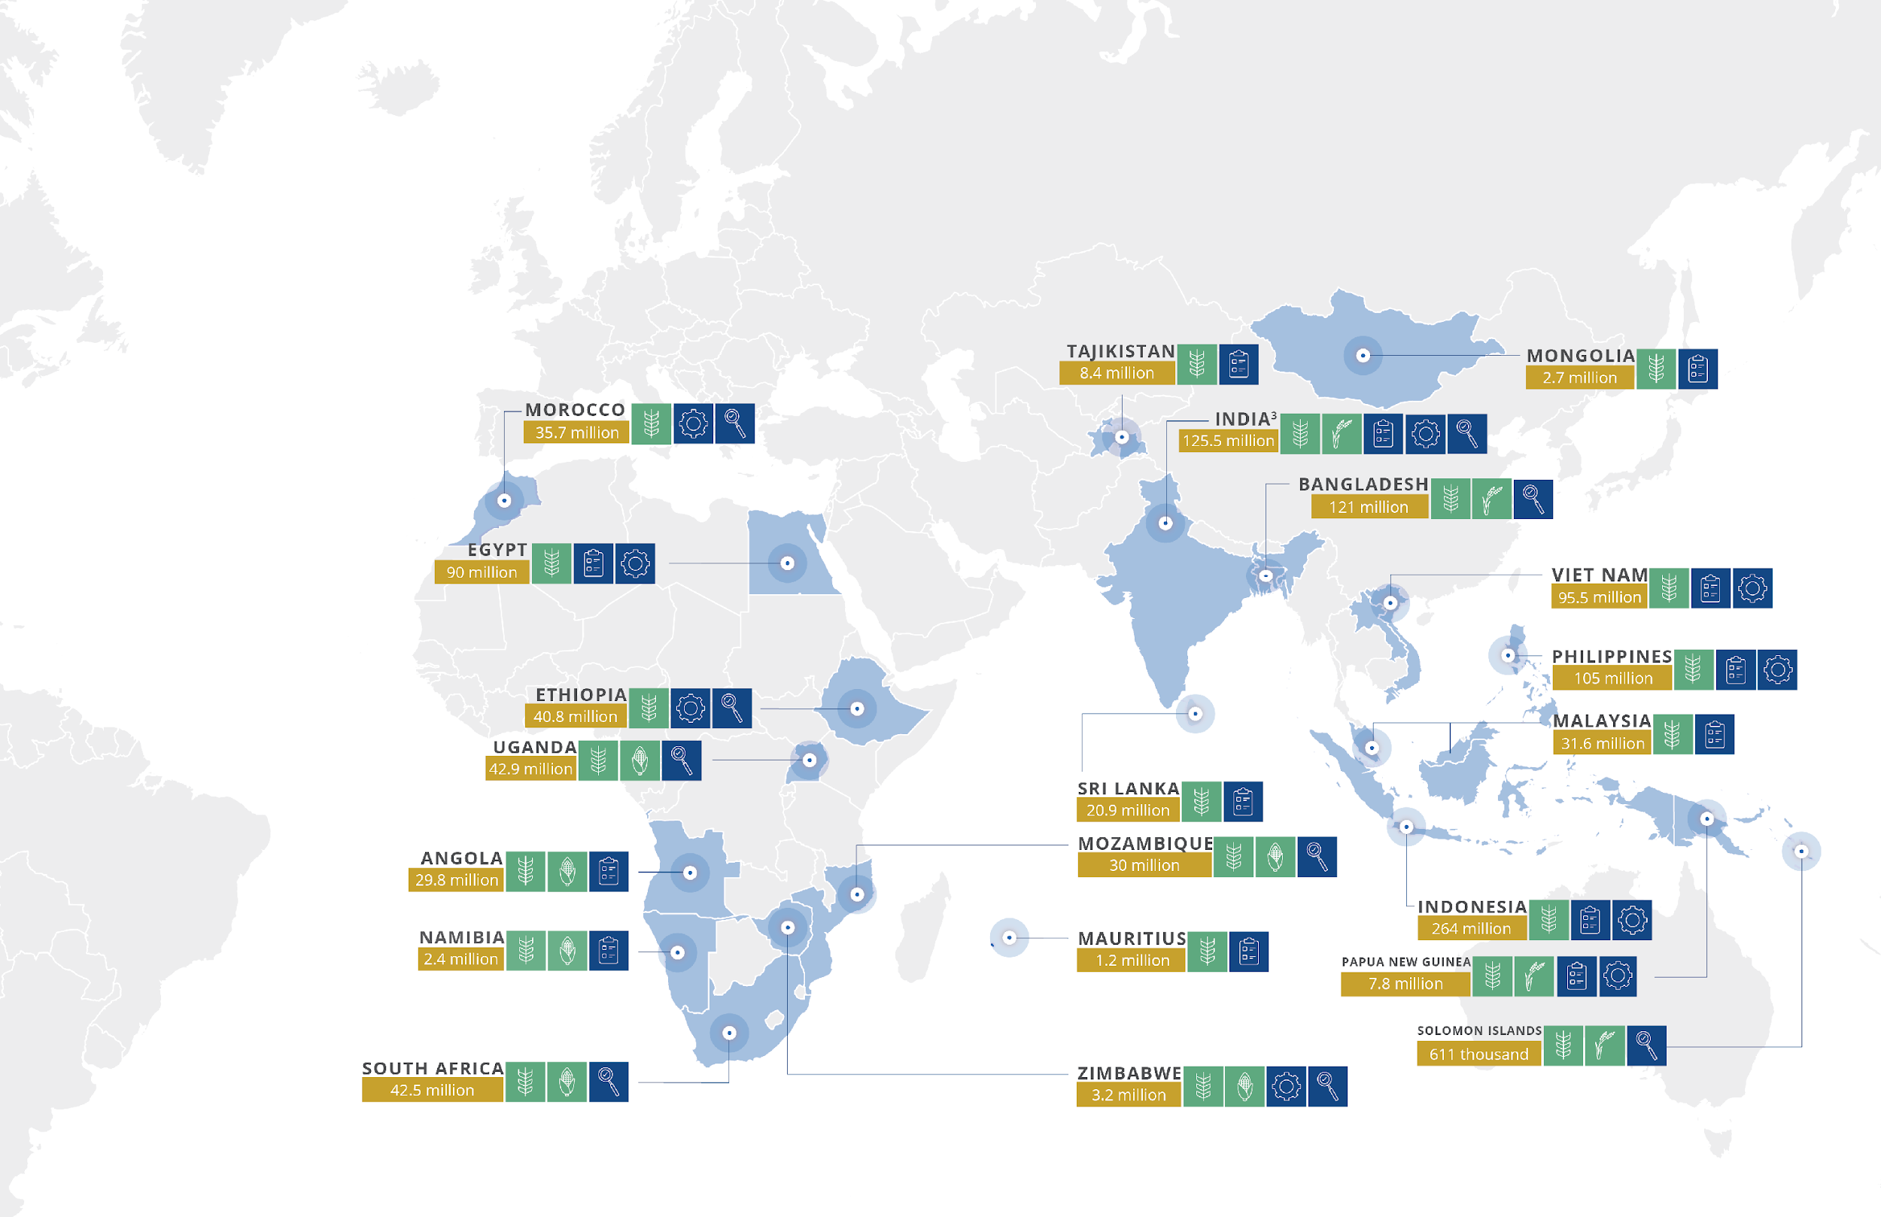
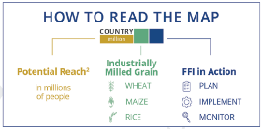
FFI around the world: 2020-21
Notes:
In 2020-21, we worked closely with our partners in 21 countries across four regions: Africa, Asia-Pacific, Europe, and India, to reduce the risk of micronutrient deficiencies for nearly 1 billion people.
Through our strategy, we help countries plan, implement, and monitor self-sustain grain fortification programs. You can see what type of assistance for which grains we provided in this map.

Slide 6
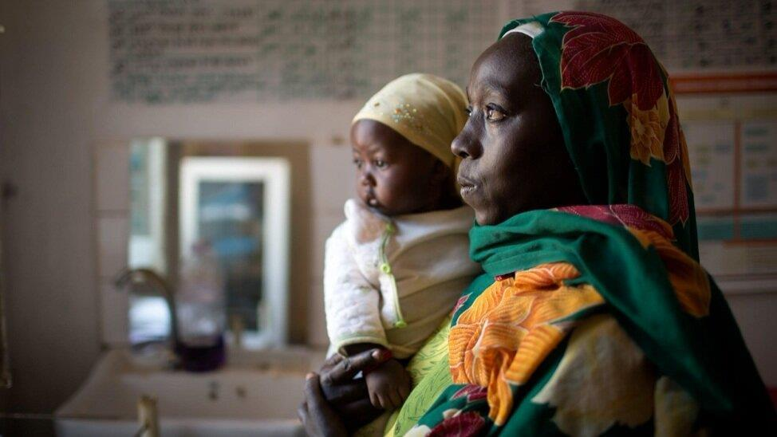

The challenge
2 billion
People worldwide suffer the effects of micronutrient malnutrition.
250 million
Women of reproductive age are affected by iron deficiency anemia, doubling their risk for maternal death.
75%
Of children born with brain and spinal birth defects die before their fifth birthday.
Photo: Muna Ibrahim/UNICEF
Notes:
Why do we do this? Micronutrient deficiency is an insidious form of malnutrition that affects over 2 billion people worldwide stunting growth and learning, weakening immune systems, and contributing to the deaths of more than a million children per year.¹ Malnutrition from deficiencies of micronutrients--small amounts of vitamins and minerals--can result in several serious challenges.
Anemia is often caused by deficiencies of micronutrients including iron and zinc. Pregnant women with severe anemia are twice as likely to die during or shortly after pregnancy than non-anemic women.² Nearly 250 million women of reproductive age are affected by iron deficiency anemia; if they stood head to toe, they could reach the moon and circle it.³
Anencephaly and spina bifida are birth defects of the brain and spine that can be prevented by consuming enough folic acid, also known as vitamin B9. About 75% of children born with brain and spinal birth defects die before their fifth birthday.⁴ Though spina bifida has varying degrees of severity, it often leads to life-long disability and enormous costs for healthcare systems. Anencephaly is always fatal.
This is unacceptable, and FFI is committed to being part of the solution. Fortification has the power to eliminate these effects of micronutrient deficiency.
In fact, it already is--research published using FFI data credited fortification with preventing 62,670 brain and spine birth defects globally in one year for an average of 172 healthier babies a day.⁵
Sources:
⁽¹⁾ von Grebmer, K., et al. 2014 Global health index: the challenge of hidden hunger. Welthungerhilfe, International Food Policy Research Institute, and Concern Worldwide. 2014.
⁽²⁾ Daru, J., et al. Risk of maternal mortality in women with severe anemia during pregnancy and postpartum: a multilevel analysis. The Lancet Global Health. 2018.
⁽³⁾ World Health Organization. The global prevalence of anemia in 2011. 2015.
⁽⁴⁾ Blencowe, H., et al. Estimates of global and regional prevalence of neural tube defects for 2015: a systematic analysis. Annals of the New York Academy of Sciences. 2018.
⁽⁵⁾ Kancherla, V., et al. A 2019 global update on folic acid‐preventable spina bifida and anencephaly. Birth Defects Research. 2020; 1– 13.

Slide 7
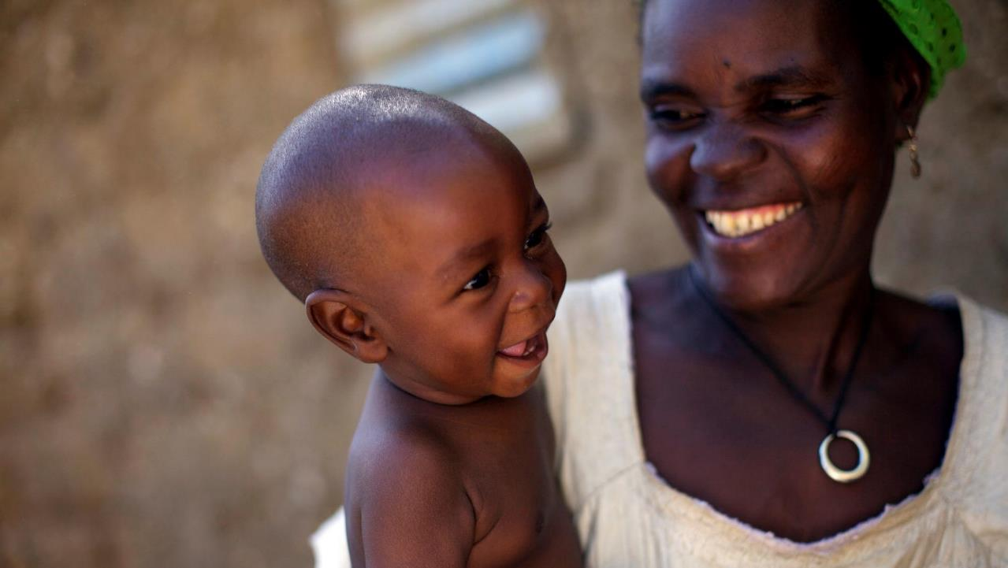
An additional 82% of
birth defects of the
brain and spine¹
and 34% of global
anemia cases²
could still be prevented through adequate
intake of iron and
folic acid.
The global gap
¹ https://www.ncbi.nlm.nih.gov/pubmed/30070772
² https://www.ncbi.nlm.nih.gov/pubmed/30997493
Photo: Benedicte Kurzen
Notes:
Yet there is still more to be done.
An additional 82% of birth defects of the brain and spine and 34% of global anemia cases could still be prevented through adequate intake of iron and folic acid.
As the Food Fortification Initiative, our mission is to close this global gap and to build a stronger, smarter, healthier future for billions of people.

Slide 8
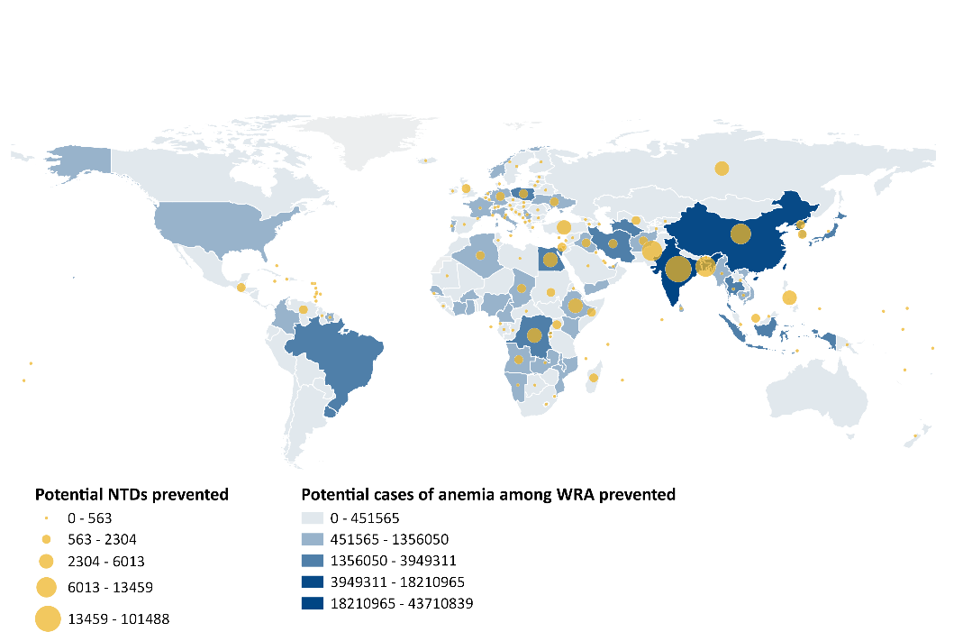
Potential neural tube defects (NTDs) and anemia that could be prevented through fortification
WRA: women of reproductive age
Map is based on FFI estimates not yet published, 2020
Notes:
Globally, efforts to support fortification are underfunded. But the potential to prevent neural tube defects and anemia globally is tremendous.
In 2020, FFI calculated the number of neural tube defects and cases of anemia that we could prevent through mandatory fortification of wheat flour, maize flour, and/or rice with iron and folic acid.
We found that the biggest opportunities are in India, China, and Bangladesh
India: 20,070 neural tube defects / 43.7 million cases of anemia among WRA that could be prevented with iron and folic acid fortification
China: 13,459 neural tube defects / 18.2 million cases of anemia among WRA that could be prevented with iron and folic acid fortification
Bangladesh: 12,327 neural tube defects / 4.8 million cases of anemia among WRA that could be prevented with iron and folic acid fortification

Slide 9
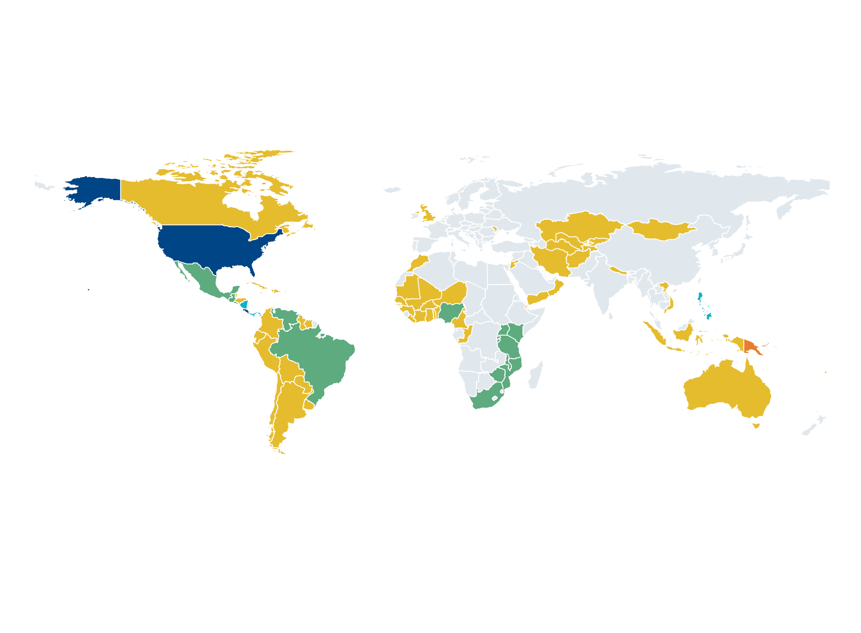
87 countries with mandatory legislation to fortify industrially milled flour and/or rice
Legislation in 86 countries mandates fortification of wheat flour alone or in combination with maize flour and/or rice.
One country (Papua New Guinea) has legislation to only fortify rice.
 | Wheat flour alone – 65 countries |  |  | Wheat flour and rice – 4 countries (Nicaragua, Panama, Philippines, Solomon Islands)
 | Rice alone – 1 country (Papua New Guinea) |  |  | Wheat flour, maize flour, and rice – 2 countries (Costa Rica and the United States)
 | Wheat flour and maize flour –15 countries |  |  | No mandatory fortification legislation or data not available
Legislation has effect of mandating grain fortification with at least iron or folic acid. Legislation status from the Food Fortification Initiative (www.FFInetwork.org) April 2021.
Notes:
This map shows countries that have mandatory legislation wheat flour, maize flour, and rice fortification as of April 2021. We encourage mandatory rather than voluntary fortification because legislation leads to country-wide fortification which creates the desired health impact. Country-wide fortification is usually not achieved without legislation.

Slide 10
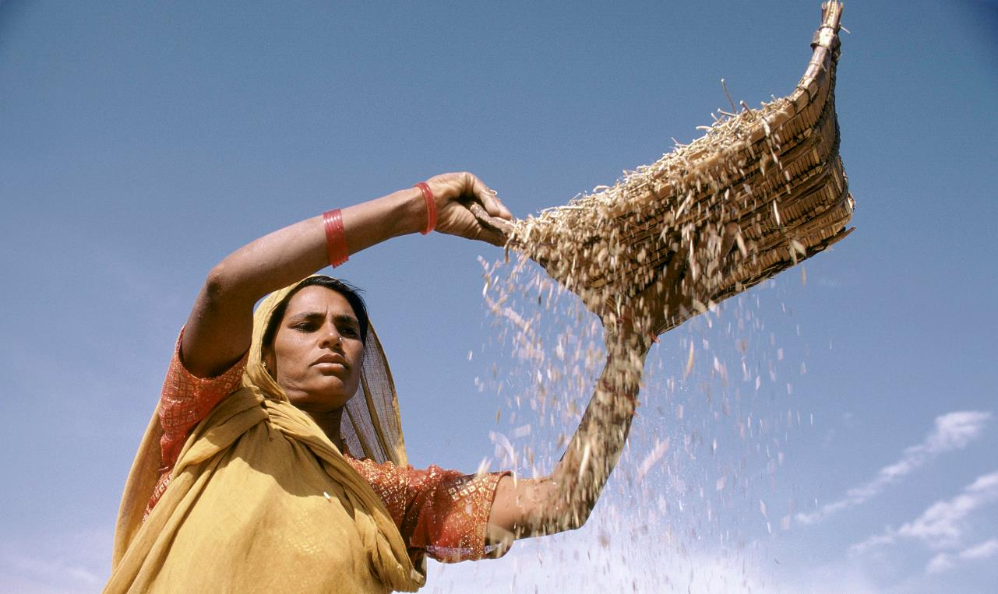
UNMET POTENTIAL
Most of the world’s industrially milled grains are not yet fortified.
 | WHEAT FLOUR | MAIZE FLOUR | RICE
 | million metric tons | million metric tons | million metric tons
Available for human consumption | 355 | 90 | 377
Industrially milled | 282 | 32 | 210
Industrially milled and fortified | 90 | 17 | 2
% industrially milled and fortified | 30% | 30% | 1%
 | WHEAT FLOUR | MAIZE FLOUR | RICE
 | million metric tons | million metric tons | million metric tons
Available for human consumption | 391 | 101 | 391
Industrially milled | 316 | 26 | 226
Industrially milled and fortified | 100 | 9 | 3
% industrially milled and fortified | 32% | 34% | 1%
Photo: Ray Witlin
Notes:
The first line in this table is the amount of cereal grains available for human consumption.
The second line is the amount of that cereal grains that is industrially milled.
The third line is the metric tons of industrially milled grains that are fortified.
This means that 63% of the cereal grain consumed is industrially milled and only 20% of that grain is fortified.
The opportunity is to fortify all industrially milled cereal grain. At FFI, our unique mission is to fill this gap.
FFI is the only organization to monitor and annually update estimates for fortification of industrially milled cereal grains. This data is extremely useful and often cited by others working in the fortification space as well as by policymakers to make data-driven decisions.
This methodology has been institutionalized in the Global Fortification Data Exchange (GFDx), a data visualization platform formed in partnership with IGN, GAIN, and the Micronutrient Forum with support from the Bill and Melinda Gates Foundation.
Source: Food and Agriculture Organization of the United Nations (FAO) for 2013.
FFI calculations. Food Fortification Initiative. 2020 Annual Report. FFI: Atlanta, USA 2021. Accessed at:
https://www.ffinetwork.org/annual-reports

Slide 11

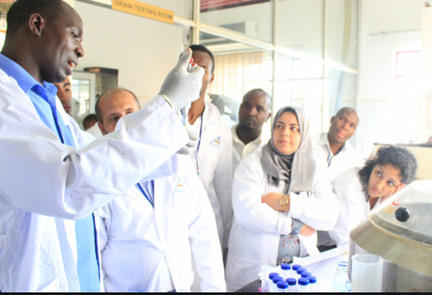
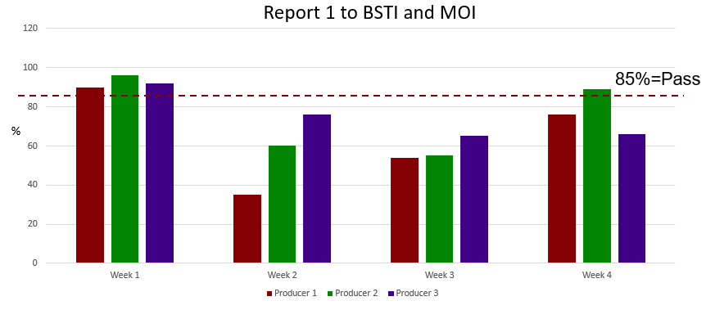
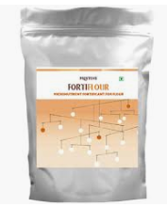

FortifyMIS: Innovative Online Solution to Simplify Data Collection and Improve Program Outcomes
Purpose: Aggregate data to better track product compliance and improve fortification programing
Users: Millers, government food control authorities, laboratories
Trainings currently occurring in Bangladesh, Mozambique, Tanzania
Results are analyzed and summarized visually on dashboards giving a producer-specific or national picture of compliance
Data is entered into FortifyMIS via a hand-held device
Audit and/or inspection results from producers, border points, or markets is collected
Notes:
One example of FFI’s work to innovate improvements to fortification programming around the world is FortifyMIS.
In countries with an enabling environment for fortification, FFI and the Global Alliance for Improved Nutrition (GAIN) are rolling out a web-based management information system (or MIS) designed specifically for monitoring national food fortification programs and capturing program compliance information. By compliance, I mean data on whether or not the correct amounts of vitamins and minerals have been added to the fortified foods per the national standard.
Called, FortifyMIS, it was designed in direct response to documented challenges inherent in obtaining and acting upon compliance information across national fortification programs.
The objective of the MIS is to:
Provide a practical and standardized data aggregation solution for country-specific use;
More efficiently and effectively track product compliance in real time;
Enable countries to act upon identified gaps to improve program outcomes in a timely, cost-effective, and sustainable manner.
Why is this kind of data (regulatory monitoring data) so important? We know that legislation and standards alone do not equal nutritional impact. We need to be sure that the correct amounts of vitamins and minerals are actually being added to the food according to the national standard if we are to expect any sort of health improvements. If this kind of information is not collected, the impact of the program becomes jeopardized.
Users include:
The government ministry responsible for overseeing the fortification program
Millers
Government food control authorities/regulatory inspectors
Laboratories
FFI and GAIN are currently conducting trainings in Bangladesh, Mozambique, Tanzania
Key considerations:
FortifyMIS is not a replacement for a national monitoring system and requires a monitoring framework to exist and already be in use.
FortifyMIS should not create any new work or new procedures. It uses existing procedures more effectively.
Country-specific data will not be shared. There is no requirement or automatic data linkage made between FortifyMIS and implementing partners or global reporting mechanisms. However, data sharing is encouraged.

Slide 12
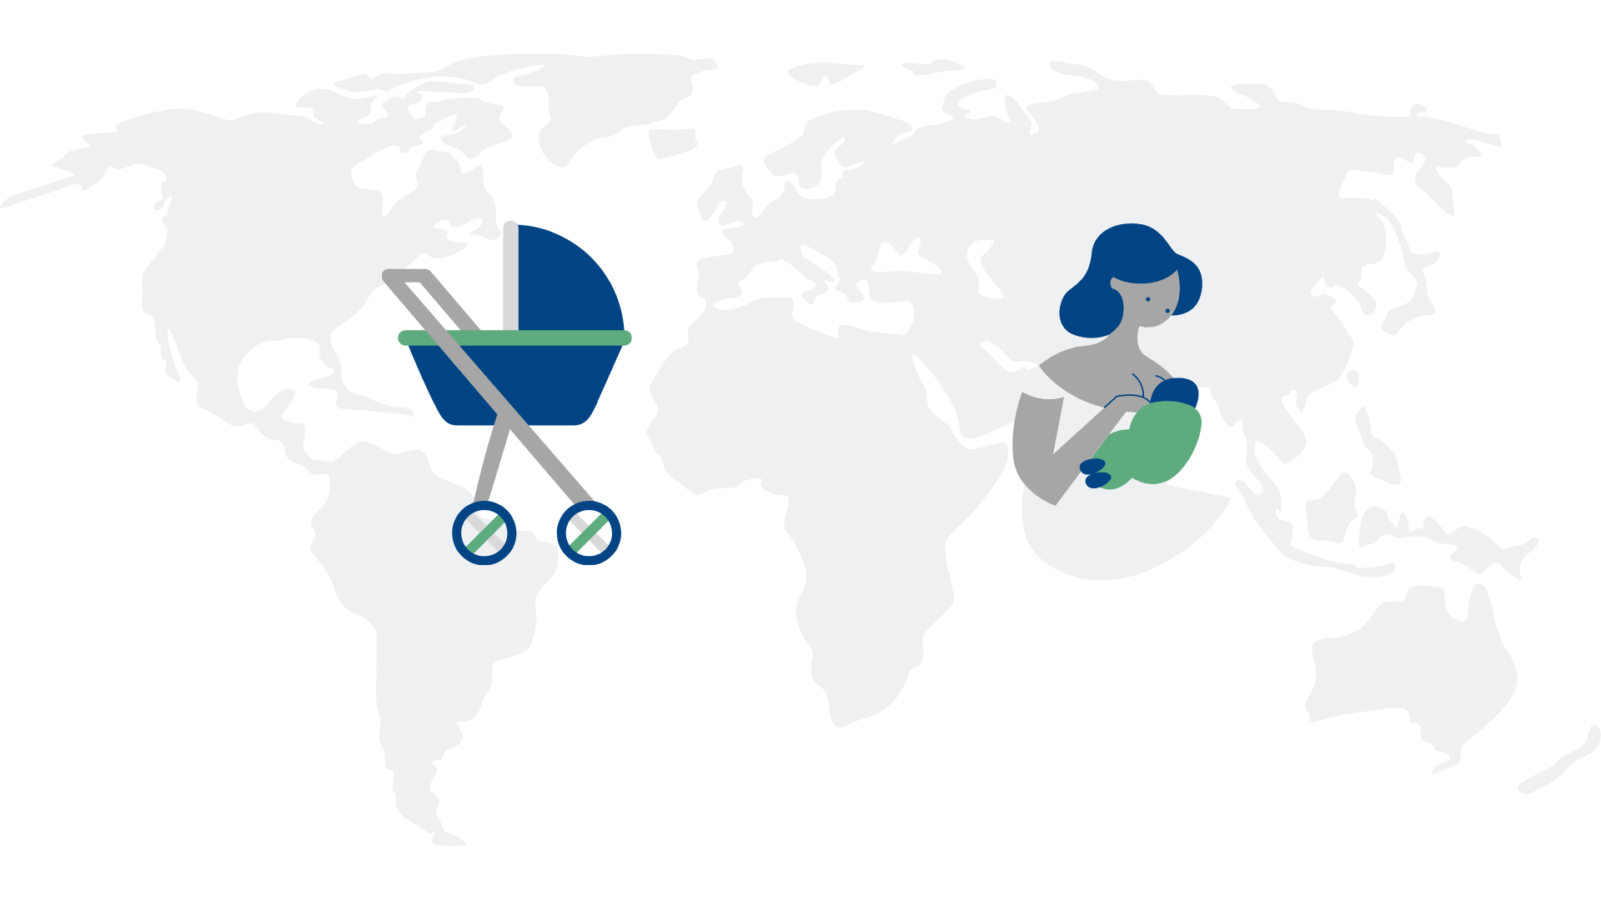
Opportunity for a fortified future
200,183
NEURAL TUBE DEFECTS CAN BE PREVENTED ANNUALLY THROUGH FORTIFICATION
151.4 MILLION
CASES OF ANEMIA AMONG WRA CAN BE PREVENTED ANNUALLY THROUGH FORTIFICATION
Notes:
By implementing successful fortification programs around the world, we can prevent 200,000 potential neural tube defects and 151.4 million cases of anemia among women of reproductive age annually--creating a stronger, smarter, and healthier future for all.

Slide 13
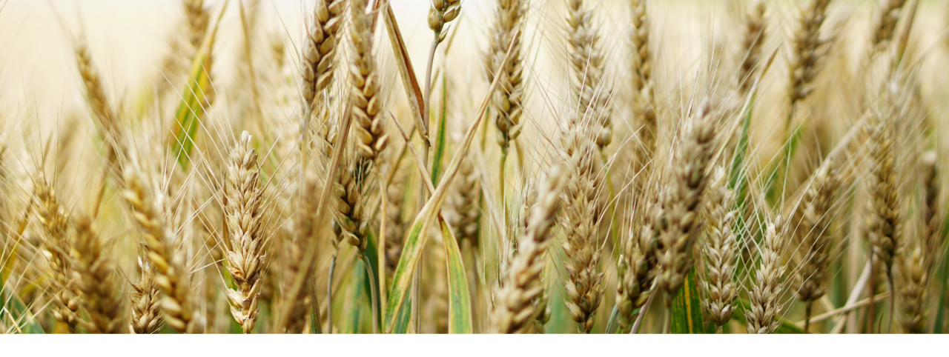
For more information:
E-mail info@ffinetwork.org
FFInetwork.org
Facebook.com/FFInetwork
Twitter.com/FFInetwork
LinkedIn

