Slide 1
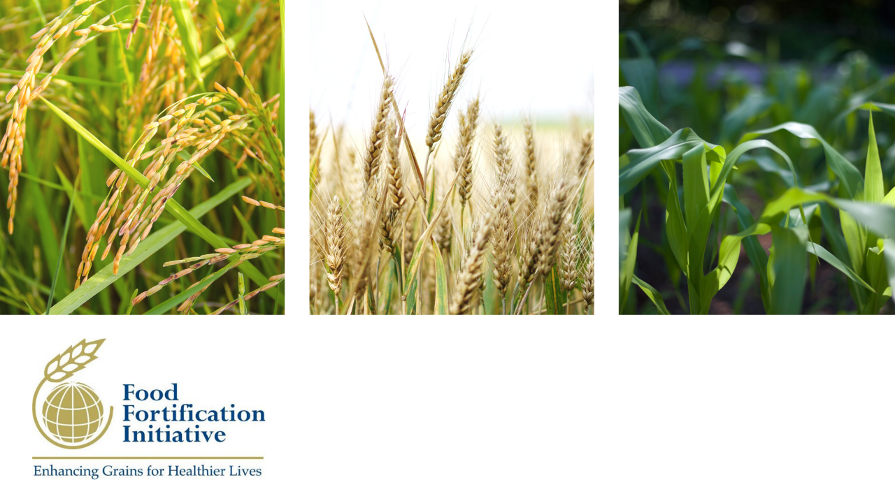
FFI’s global strategy for scaling grain fortification
APRIL 2021
Notes:
The Food Fortification Initiative (FFI) is a not for profit agency based at Emory University in Atlanta, GA. FFI operates through a unique model, bringing together voices from the public, private, and civic sectors in our management and in our technical assistance to make sustainable change.
FFI is managed by an Executive Management Team that includes large multinational agribusiness companies like Cargill and key partners in the fortification space like the Global Alliance for Improved Nutrition.
Since FFI was formed in 2002, we have had a uniquely strong link to the United States’ Centers for Disease Control and Prevention and UN agencies such as the World Health Organization and UNICEF.

Slide 2
FFI’s role and unique contribution
Expertise
Rigor
Focus
Uses in-house expertise to apply a data-driven approach to program planning, implementation, and monitoring
Operates through a unique model, bringing together voices from the public, private, and civic sectors
Conducts supply chain analyses for any given grain to discover and act on opportunities to advance fortification
Documents and publishes up to 196 countries’ annual progress toward successful cereal grain fortification
Focuses exclusively on large-scale fortification of the three most consumed grains: wheat flour, maize flour, and rice
Disciplined people
Disciplined thought
Disciplined action
Notes:
We are a unique initiative within the nutrition space:
Expertise: FFI has in-house leadership and technical expertise to apply a data-driven approach to program planning, implementation, and monitoring.
We are made up of a dynamic team of 13 passionate professionals dedicated to combating malnutrition with staff in Africa, Asia, and the South Pacific. Our staff not only helps partners plan, implement, and monitor fortification using evidence-based methods; they also help generate the evidence and data-driven methods for fortification programs. For example, FFI's senior nutrition scientist, who is also an Emory University research professor, has dual roles. She 1) provides technical assistance to staff and partners on scientific, nutrition, and monitoring issues, and 2) generates and collates evidence on the public health impact of grain fortification.
Rigor:
FFI operates through a unique model, bringing together voices from the public, private, and civic sectors through FFI's Executive Management Team and FFI’s technical assistance to make sustainable change.
FFI conducts supply chain analyses for any given grain to discover and act on opportunities to advance fortification.
FFI documents and publishes up to 196 countries’ annual potential and progress toward successful cereal grain fortification.
Focus: We know what we are deeply passionate about, we know what we can be the best in the world at, and we know what the key to a stronger, smarter, and healthier future is. FFI is the only global group that focuses exclusively on large-scale fortification of the three most consumed grains: wheat flour, maize flour, and rice.
Source: Adapted from the Good to Great model by Jim Collins

Slide 3
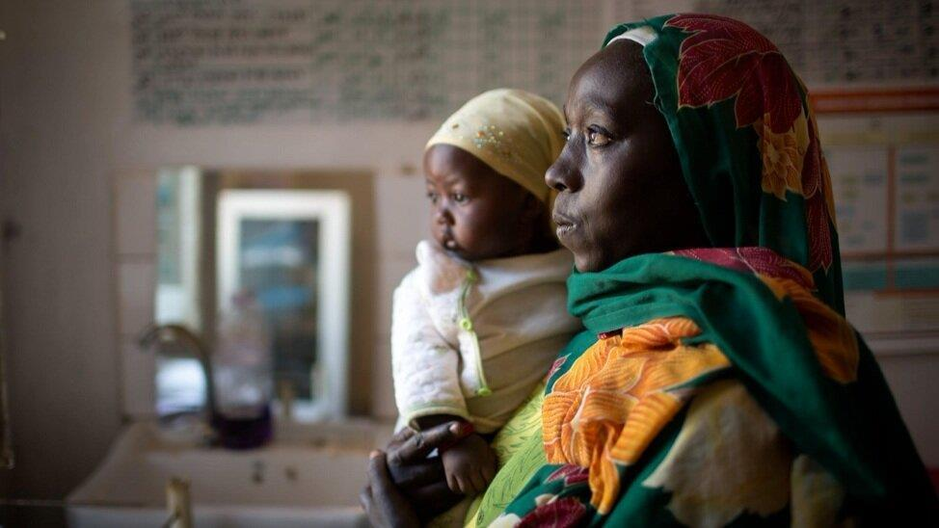

The challenge
2 billion
People worldwide suffer the effects of micronutrient malnutrition.
250 million
Women of reproductive age are affected by iron deficiency anemia, doubling their risk for maternal death.
75%
Of children born with brain and spinal birth defects die before their fifth birthday.
Photo: Muna Ibrahim/UNICEF
Notes:
Micronutrient deficiencies are an insidious form of malnutrition that affects over 2 billion people worldwide stunting growth and learning, weakening immune systems, and contributing to the deaths of more than a million children per year.¹ Malnutrition from deficiencies of micronutrients--small amounts of vitamins and minerals--can result in several serious challenges.
Anemia is often caused by deficiencies of micronutrients including iron and zinc. Pregnant women with severe anemia are twice as likely to die during or shortly after pregnancy than non-anemic women.² Nearly 250 million women of reproductive age are affected by iron deficiency anemia; if they stood head to toe, they could reach the moon and circle it.³
Anencephaly and spina bifida are birth defects of the brain and spine that can be prevented by consuming enough folic acid, also known as vitamin B9. About 75% of children born with brain and spinal birth defects die before their fifth birthday.⁴ Though spina bifida has varying degrees of severity, it often leads to life-long disability and enormous costs for healthcare systems. Anencephaly is always fatal.
This is unacceptable, and FFI is committed to being part of the solution. Fortification has the power to eliminate these effects of micronutrient deficiency.
In fact, it already is--research published using FFI data credited fortification with preventing 62,670 brain and spine birth defects globally in one year for an average of 172 healthier babies a day.⁵
Sources:
⁽¹⁾ von Grebmer, K., et al. 2014 Global health index: the challenge of hidden hunger. Welthungerhilfe, International Food Policy Research Institute, and Concern Worldwide. 2014.
⁽²⁾ Daru, J., et al. Risk of maternal mortality in women with severe anemia during pregnancy and postpartum: a multilevel analysis. The Lancet Global Health. 2018.
⁽³⁾ World Health Organization. The global prevalence of anemia in 2011. 2015.
⁽⁴⁾ Blencowe, H., et al. Estimates of global and regional prevalence of neural tube defects for 2015: a systematic analysis. Annals of the New York Academy of Sciences. 2018.
⁽⁵⁾ Kancherla, V., et al. A 2019 global update on folic acid‐preventable spina bifida and anencephaly. Birth Defects Research. 2020; 1– 13.

Slide 4
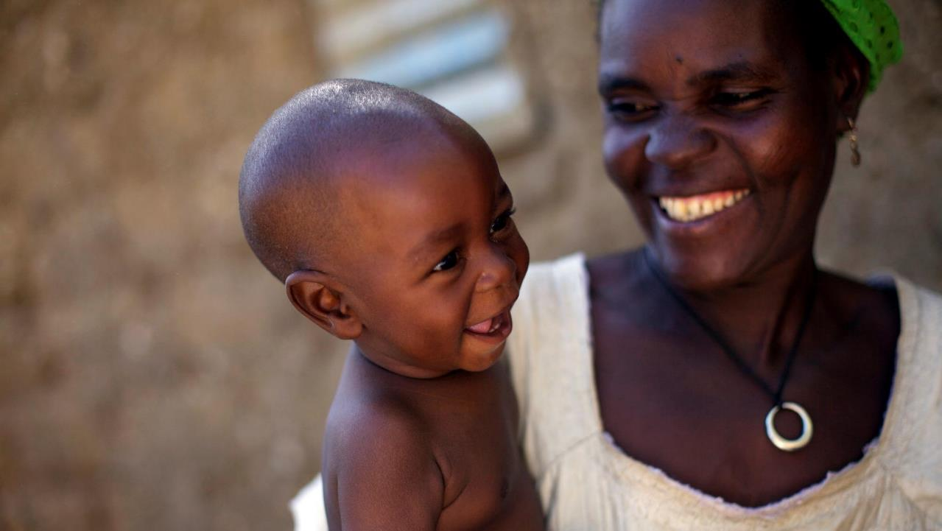
An additional 82% of
birth defects of the
brain and spine¹
and 34% of global
anemia cases²
could still be prevented through adequate
intake of iron and
folic acid.
The global gap
¹ https://www.ncbi.nlm.nih.gov/pubmed/30070772
² https://www.ncbi.nlm.nih.gov/pubmed/30997493
Photo: Benedicte Kurzen
Notes:
Yet there is still more to be done.
An additional 82% of birth defects of the brain and spine and 34% of global anemia cases could still be prevented through adequate intake of iron and folic acid.
As the Food Fortification Initiative, our mission is to close this global gap and to build a stronger, smarter, healthier future for billions of people.
(FFI has recently calculated the reach and potential impact (on NTDs and anemia) of fortifying in all countries globally (no restriction on economic status) that consume >50 g/c/d and that have >30% industrially processed grains. We will be able to access this for those countries with and without mandatory fortification in place.)

Slide 5
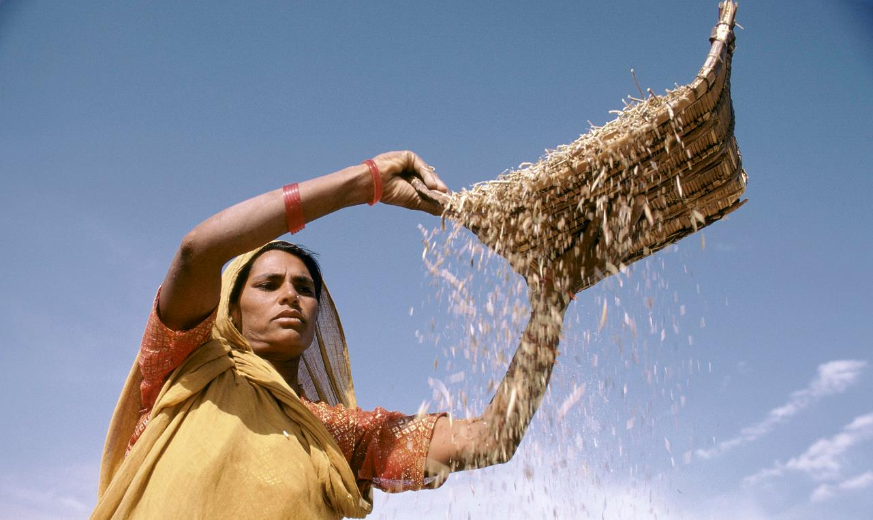
UNMET POTENTIAL
Most of the world’s industrially milled grains are not yet fortified.
 | WHEAT FLOUR | MAIZE FLOUR | RICE
 | million metric tons | million metric tons | million metric tons
Available for human consumption | 355 | 90 | 377
Industrially milled | 282 | 32 | 210
Industrially milled and fortified | 90 | 17 | 2
% industrially milled and fortified | 30% | 30% | 1%
 | WHEAT FLOUR | MAIZE FLOUR | RICE
 | million metric tons | million metric tons | million metric tons
Available for human consumption | 391 | 101 | 391
Industrially milled | 316 | 26 | 226
Industrially milled and fortified | 100 | 9 | 3
% industrially milled and fortified | 32% | 34% | 1%
Photo: Ray Witlin
Notes:
The first line in this table is the amount of cereal grains available for human consumption.
The second line is the amount of that cereal grains that is industrially milled.
The third line is the metric tons of industrially milled grains that are fortified.
This means that 63% of the cereal grain consumed is industrially milled and only 20% of that grain is fortified.
The opportunity is to fortify all industrially milled cereal grain. At FFI, our unique mission is to fill this gap.
FFI is the only organization to monitor and annually update estimates for fortification of industrially milled cereal grains. This data is extremely useful and often cited by others working in the fortification space as well as by policymakers to make data-driven decisions.
This methodology has been institutionalized in the Global Fortification Data Exchange (GFDx), a data visualization platform formed in partnership with IGN, GAIN, and the Micronutrient Forum with support from the Bill and Melinda Gates Foundation.
Source: Food and Agriculture Organization of the United Nations (FAO) for 2013.
FFI calculations. Food Fortification Initiative. 2020 Annual Report. FFI: Atlanta, USA 2021. Accessed at:
https://www.ffinetwork.org/annual-reports

Slide 6
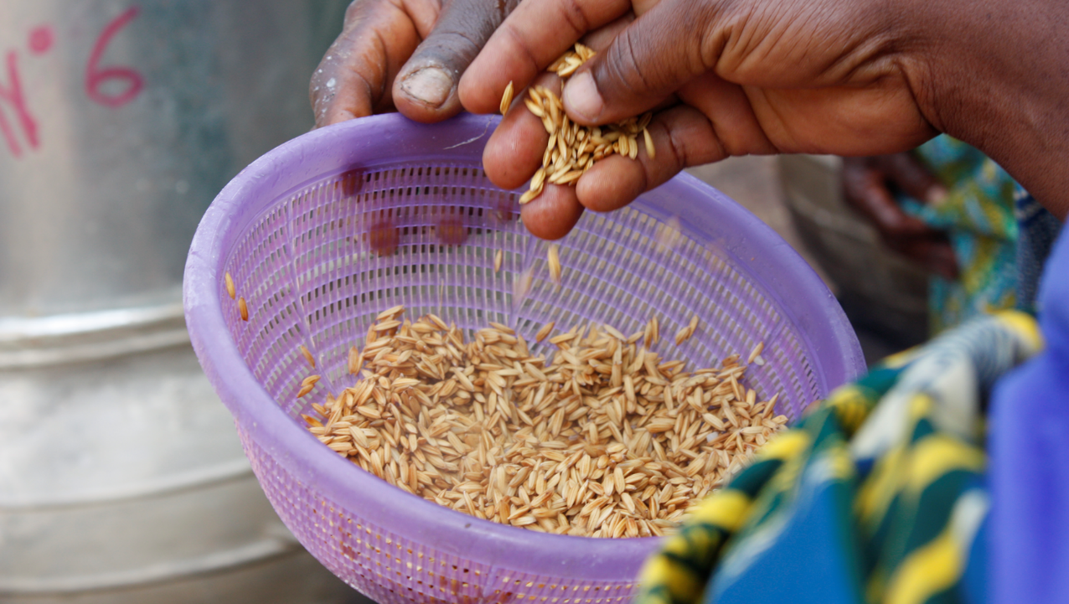
Three key steps
1. Data-driven assessment
2. Four-stage phased approach
- Explore and engage
- Map the context
- Design and develop
- Monitor for compliance and impact
3. Strategy in action
Photo: Bernd Flink
Notes:
FFI’s strategic approach to scaling large-scale grain fortification, which is based on two decades of experience conducting research and providing on-the-ground assistance, offers a replicable approach to building and strengthening fortification programs.

Slide 7
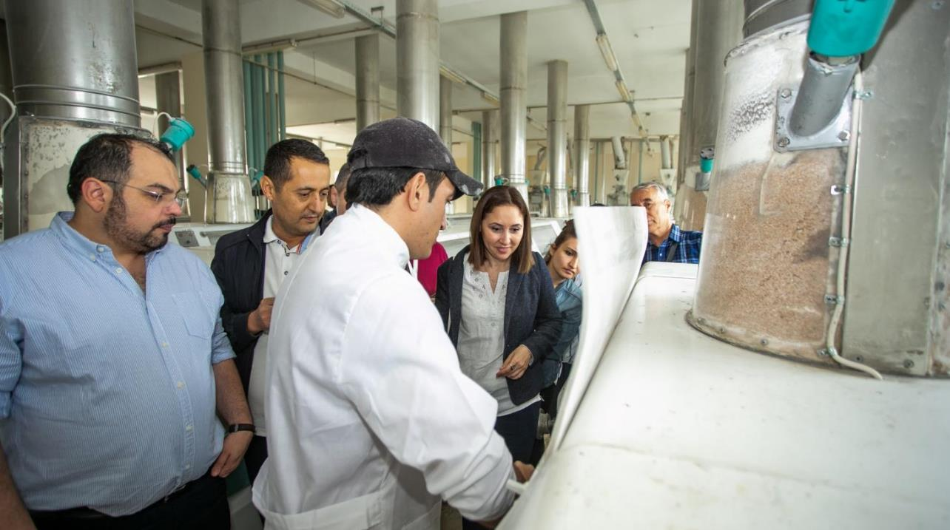
Data-driven assessment
  Our work starts with data and understanding the country context
  First, we determine if a country or state has potential and demonstrated need for fortification using:
    Consumption and milling analyses
    Nutritional need assessments/analysis of existing standards
    Market analyses
    Political readiness assessments
    Current fortification reviews
    Partner interviews
Notes:
Unlike other organizations in the fortification space, FFI has been able to complete data-driven assessments of fortification opportunities for all regions in the world. These interdisciplinary and comprehensive assessments can be used to prioritize fortification opportunities as well as lay the groundwork for building or strengthening a fortification program. This data has been used internally to drive priorities within FFI but also externally among partners working in fortification.

Slide 8
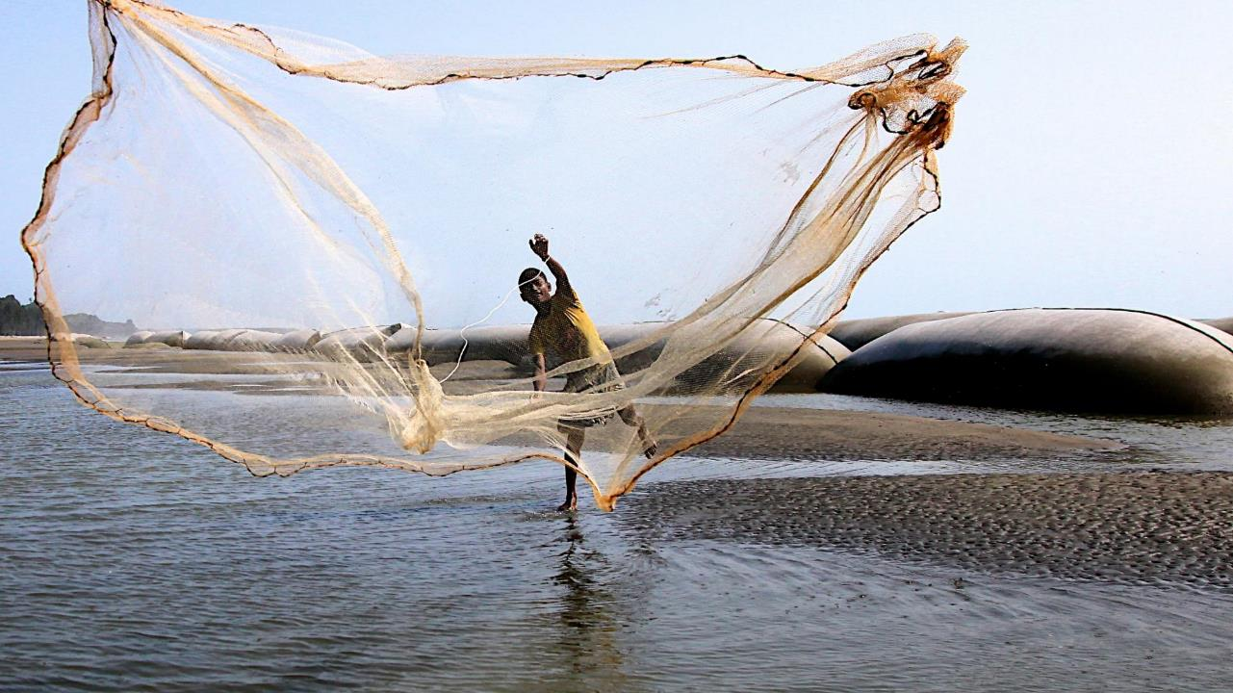
Four-stage phased approach
Photo: Hasim Hayder
Notes:
FFI chooses geographies, regions, states and provinces through rigorous research. We take a holistic, objective approach with the goal to help eliminate micronutrient deficiencies in every country in the world where industrially milled cereal grain in commonly consumed. FFI does not have a predetermined set of countries it will support; instead, it relies on data to identify where the needs and opportunities are greatest.
Why do we take this approach? Because of all the roadblocks that will happen along the way. There’s too much that is not in our control.

Slide 9




Strategic phases of fortification
Explore and engage
PLAN
Data-driven opportunity
Monitor for compliance and impact
Map the context
IMPLEMENT
Design and develop
MONITOR
Notes:
FFI helps countries plan, implement through technical assistance, and monitor fortification programs. We do this through our four-stage phased approach, which articulates key milestones to be achieved before moving to the next phase.
I wanted to call your attention to the last phase, “monitor for compliance and impact.” Though we help countries establish and strengthen their fortification monitoring efforts, FFI doesn’t conduct impact studies due to the budgetary requirements involved in conducting thorough impact evaluations.
Instead, FFI relies on our network of partners to conduct and collect this data. This may take the form of a stand-alone micronutrient deficiency survey or it might involve inferring impact from data already collected through Demographic Health Surveys (DHS) pre- and post-fortification. What we’ve seen and know is that the science-based evidence that fortification works and leads to the intended health improvements is overwhelming.

Slide 10
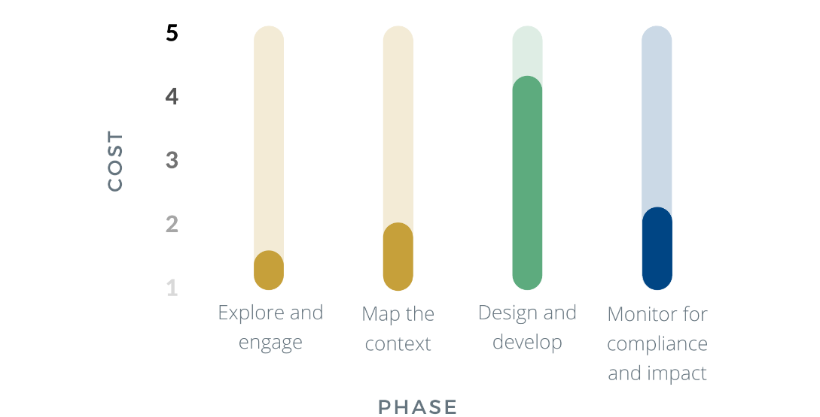
Strategic phases of fortification
Notes:
From the start of a project, FFI’s focus is on creating a sustainable fortification program that won’t need future external funding. We want to put ourselves out of business one day.
Our strategic phases articulate a methodical approach to maximize the use of funds and staff resources in the most efficient manner.

Slide 11
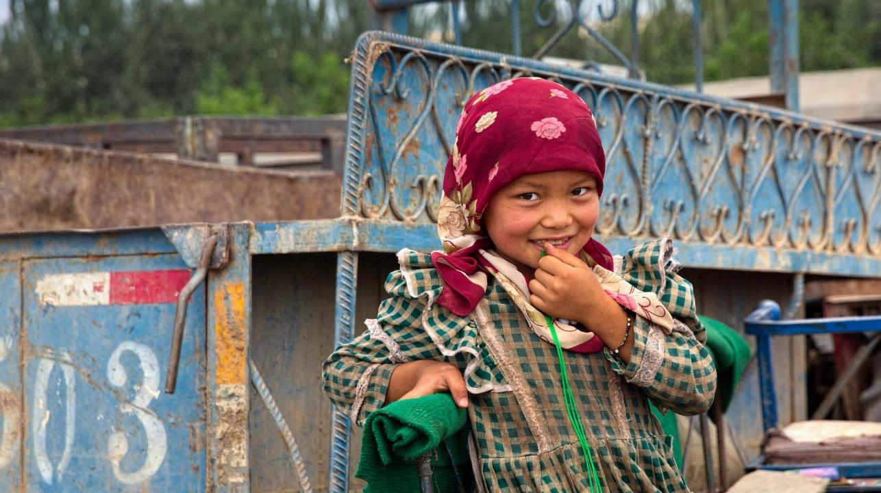
1. Explore and engage
  Once a data-driven opportunity is determined:
    Engage private sector
    Engage birth defects groups, neurosurgeons, and consumer associations
    Identify key challenges and opportunities
    Identify a champion/champions within government
    Determine what it will take to move forward
    Permission and willingness of government to move
    to next phase
Photo: Aftab Uzzaman
Notes:
FFI brings a unique set of connections to this phase:
The Executive Vice President of the International Association of Operative Millers (IAOM) sits on our EMT and connects FFI to private sector millers around the world.
The Center for Spina Bifida Prevention, an organization that represents birth defects groups, neurosurgeons, and consumer associations.

Slide 12
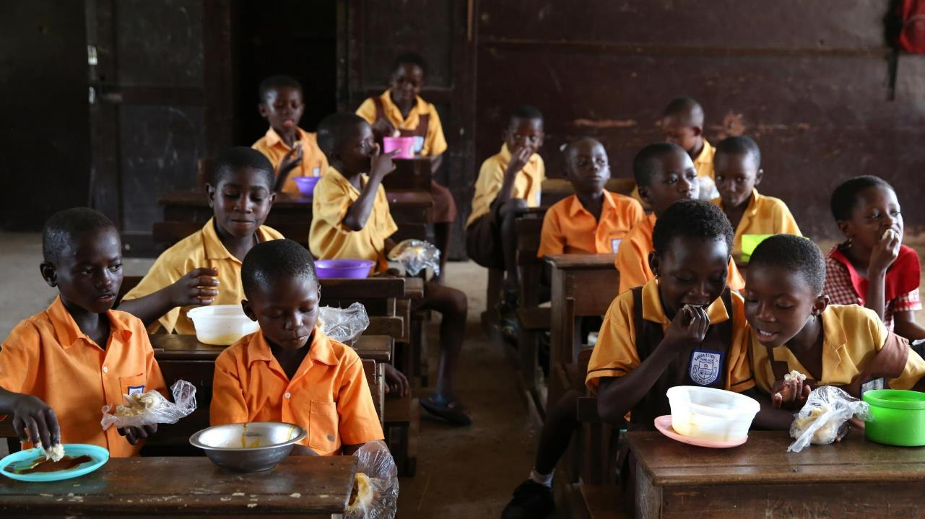
2. Map the context
Conduct a thorough supply chain diagnostic
Assess industry structure including readiness and reach of mills
Assess monitoring structure and needs
Map the legislative process
Assess budgetary needs (initial investment by sector and annual recurring costs) to ensure commitment and sustainability
If necessary, conduct a cost-benefit analysis making the case for fortification’s impact on national health and economic indicators
  Formal presentation to government to recommend effective staples and market channels based on diagnostic results
  Government plan, permission, and support to move to the next phase
Photo: Dominic Chavez
Notes:
FFI is uniquely poised to effectively help partners in this phase:
FFI’s prescriptive supply-chain diagnostic methodology provides a reliable picture of fortification opportunities by grain and market channel.
FFI has found that assessing budgetary needs (initial investment by sector and annual recurring costs) to ensure commitment is absolutely critical to the success and sustainability of a program.
Before moving on to the next phase, FFI provides governments with a realistic picture of the opportunity to fortify, as well as the concrete steps to create a successful fortification program. Without gaining governmental commitment to realistic goals in this phase, success is not possible.

Slide 13
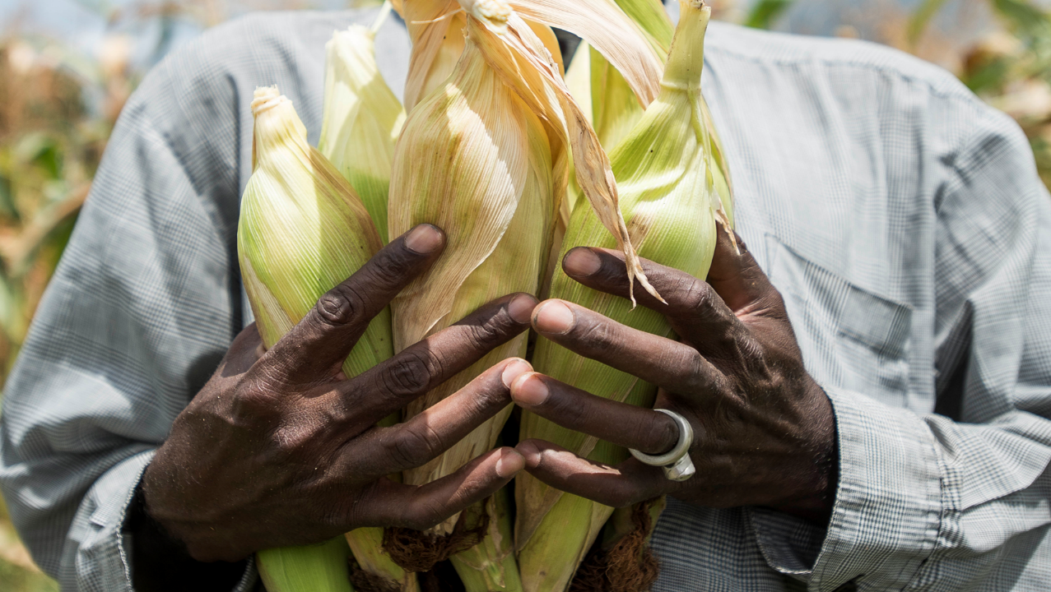
3. Design and develop
  Draft recommended standards
  Identify miller, regulatory inspector, and laboratory training needs
  Support premix procurement process
  Engage the legislative process
  Develop a communication and education strategy
  Integrate realistic fortification monitoring into existing framework
  Train millers on QA/QC practices
  Train regulatory monitoring inspectors and lab staff; map agency responsibilities
  Facilitate the passage of legislation
  Develop a National Fortification Guidelines document and national logo, as necessary
    Clear budget and implementation plan
    Fortification program is implemented and ready to scale
Photo: RTI/Xaume Olleros
Notes:
FFI provides technical assistance to partners to design and develop a fortification program.
FFI’s uniquely robust connections to public, private, and civic partners enable it to create efficiencies and reduce duplication of efforts. For example, with a keen attention to maximize the strengths of FFI’s partners, FFI leads implementation of programs like Smarter Futures, a multi-sector partnership working to advance grain fortification in Africa.

Slide 14

4. Monitor for compliance and impact
  Support collection of monitoring data
  Ensure monitoring data is shared with relevant stakeholders
  Augment government monitoring partnerships with civic entities
  Ensure action is taken to improve program performance based upon monitoring data
  As relevant, partner with stakeholders to measure impact
    Ensure program reaches intended population
Photo: Arjun Claire
Notes:
As mentioned previously, FFI is the only organization to monitor and annually update estimates for fortification of industrially milled cereal grains that is often cited by others working in the fortification space as well as by policymakers to make data-driven decisions.
FFI also has unique approaches to augment government monitoring efforts. For example, the Pull Strategy, which FFI piloted in in Uganda and Malawi 2018-2019, engages consumer associations and disability groups to become part of program performance monitoring. A complement to government-led “push” strategies, the Pull Strategy augments government monitoring to increase the volume of fortified staple foods that meet quality and nutrition standards.

Slide 15
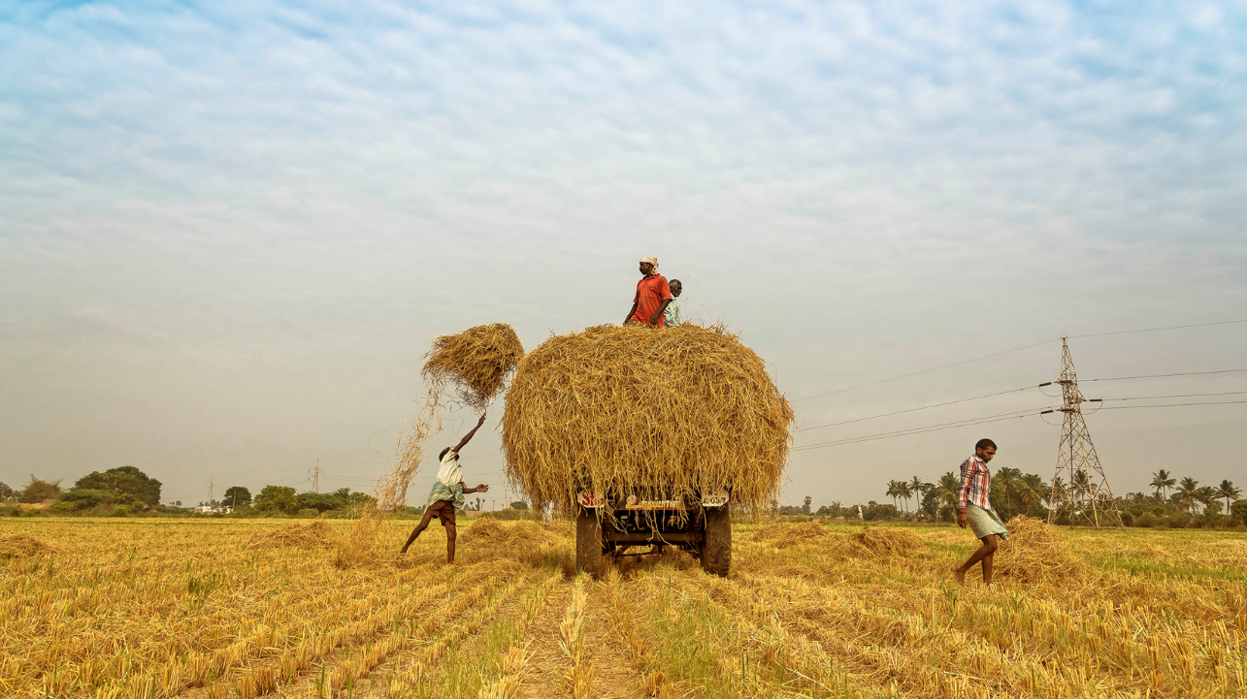
EXAMPLES OF
Strategy
in action
Photo: Muthuraman/Flickr

Slide 16

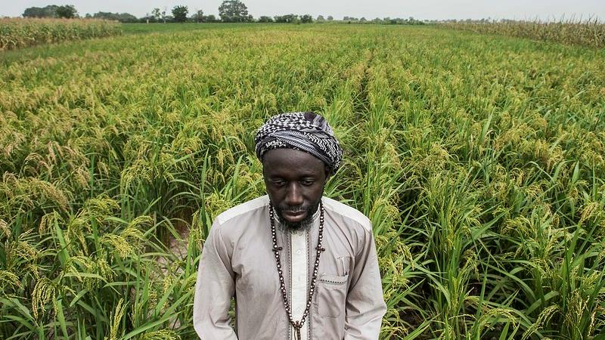
AFRICA
Data-driven assessment
Assessment of 54 African countries via:
  Partner interviews and mapping
  Socio-cultural assessment
  FFI, Global Fortification Data Exchange (GFDx), World Bank, and Food and Agriculture Organization (FAO) database analyses
Six priority country tiers were identified by combining information from:
  Partner interviews
  Updated country profiles
  Updated FFI country-specific color codes
  Results of a priority matrix exercise
Photo: RTI

Slide 17
Country priority ranking
Health impact
Ease of implementation
Population (15%)
NTDs per year (7.5%)
NTDs per 10,000 births (7.5%)
Anemia in non-pregnant woman (30%)
Urban population (5%)
% Cereal milled industrially (20%)
Cereal availability (15%)
Final score of 1-5
1 = minimal impact
5 = maximum impact
NTDs: Neural Tube Defects
% Living in urban settings (20%)
Political stability* (10%)
Government effectiveness* (10%)
Regulatory quality* (10%)
Number of industrial-sized mills (20%)
% Cereal milled industrially (10%)
Mandatory salt iodization (20%)
Final score of 1-5
1 = minimal impact
5 = maximum impact
*World Bank Indicators
Health impact and ease of implementation
combined to form total score.
17
Notes:
For each of FFI’s regional strategies, FFI has objectively ranked the fortification opportunity for each country by 1) health impact and 2) ease of implementation. This unique, methodical approach helps FFI to efficiently prioritize opportunities. This approach also helps to provide directional thinking to other organizations working in fortification.
These indicators were taken from previous regional strategies conducted by FFI (Europe and India strategies). All variables were ranked from 1-5 and then two weighted aggregate scores were created.
Proportion of cereal milled by industrial mills was designated as a Health Impact variable because if only a small proportion of the total cereal available to the population is milled by industrial mills, the impact of fortification will be small and vice versa. This variable includes imported flour which is assumed to originate from industrial mills.

Slide 18
Final Wheat Fortification Matrix
Country Ranking
 |  | Egypt | Algeria Morocco
Somalia | Sudan Liberia Congo Rep. Libya Madagascar Angola | Sao Tome & Principe Sierra Leone Gabon Tunisia | South Africa
Ethiopia Eritrea | Lesotho Eswatini Equatorial Guinea DRC Zimbabwe | Mauritius Namibia | Zambia Botswana
Burundi Comoros |  | Seychelles Rwanda
Great
Health Impact
Low
Great
Ease of Implementation
18
Notes:
This is another view of the results for the variable grouping, looking at the results dichotomously.
It’s worth noting that our political stability indicator comes from the WB’s 2017 data. Today, Algeria would not appear with such a high implementation score.

Slide 19
Final Maize Fortification Matrix
Country Ranking
Great
 | Tanzania | Zambia | South Africa
Togo Burkina Faso | Cameroon Benin | Zimbabwe | Namibia
Malawi | Eswatini Lesotho | Uganda Cabo Verde
Burundi |  | Rwanda Botswana Togo
Health Impact
Low
Great
Ease of Implementation
19

Slide 20
Final Rice Fortification Matrix
Country Ranking
Great
 | Cote d’Ivoire Mali | Senegal | Ghana
Madagascar Guinea | Egypt Nigeria Sierra Leone Liberia | Benin
Guinea-Bissau | Mauritania | Gabon Gambia Djibouti | Cabo Verde
Comoros |  | Mauritius Sao Tome & Principe
Health Impact
Low
Great
Ease of Implementation
20

Slide 21
AFRICA
Strategic targets
FFI is supporting 13 countries between 2018-2021 and seeking additional funding post 2021 to continue this support.
EXPLORE & ENGAGE | MAP THE CONTEXT | DESIGN & DEVELOP | MONITOR
Algeria | Egypt | Ethiopia | Malawi
Angola | Botswana | Zimbabwe | Mozambique
Mauritius | Namibia |  | South Africa
Morocco |  |  | Uganda
Photo: RTI
Notes:
Proposed activities, pending funding:
Wheat and maize
FFI would:
Collaborate with national leaders to secure buy-in for a comprehensive national grain fortification program
Support drafting of national standards that would identify the type and level of nutrients to be added to wheat flour and/or maize flour based on current consumption patterns and nutritional needs
Support millers and government inspectors in the scale-up for fortification
Support millers and government in the design of effective monitoring frameworks for the fortification program
Rice
The highest per capita consumption of rice outside of Asia is in West Africa. Specifically, 12 West African countries present an opportunity to reach an additional 146 million people with fortified rice. These are countries in which there is limited volume of industrially milled domestic rice but high volumes of imported rice. Several countries in West Africa already fortify wheat flour, salt, and cooking oil. These countries understand why fortification is important and why mandatory fortification is necessary. Fortifying rice would fill a nutrition gap not being addressed by existing programs. However, several countries would need to collectively mandate imported rice fortification to make it economically feasible.
FFI’s unique contribution
A trusted partner in the region, FFI has worked closely with several West African countries on wheat and maize flour fortification programs. FFI also provides technical leadership to partner agencies and government institutions interested in pursuing rice fortification in the West Africa region.
Proven results
FFI is an experienced leader and valuable resource in global rice fortification. The first to develop a rapid, qualitative test that regulators can use to monitor rice fortification, FFI has been a key advocate and technical partner for countries in Asia who seek to fortify rice. With FFI’s assistance from planning to implementation, the Solomon Islands now mandates rice fortification--a move that improves the nutrition of more than 500,000 people and will prevent debilitating birth defects in the years to come.
Looking forward
FFI’s proposed activities and milestones would occur in three phases over three years:
BASELINE
Activities
Develop advocacy and knowledge toolkits for partners and policy makers
Assess export supply chains in key rice origin countries (India, Thailand, Viet Nam, and Pakistan)
Assess price implications of imported fortified rice for the consumer
Develop and promote minimum nutrient standards
Develop linkages with regional and national bodies
Engage partners on strategies to add rice fortification into policies and legislation
Milestones
Export supply chain analyses completed in four rice origin countries
Advocacy and knowledge toolkit developed and finalized
ENGAGEMENT
Activities
Plan, coordinate, and hold meetings for policy makers; map legislative process
Raise awareness with public, private, and civic sector partners and provide technical assistance as necessary
Assess national import control systems
Develop and activate communications strategy
Add rice fortification to regional and national nutrition agendas by increasing awareness at targeted nutrition-related events
Milestone
Secured commitment from country governments for national and regional legislative action plans for mandatory and social safety net fortification
STRATEGY IMPLEMENTATION
Activities
Support local partners and policy makers to introduce mandatory fortification
Conduct training as needed to support a robust regulatory monitoring system
Provide technical assistance as necessary to rice importers
Provide technical assistance as necessary to national rice millers developing industrial capacity
Identify gaps and opportunities for improved import control
Milestones
Mandatory legislation drafted
Effective national/regional standards set
Regulatory monitoring systems developed
Implementation of fortified rice

Slide 22
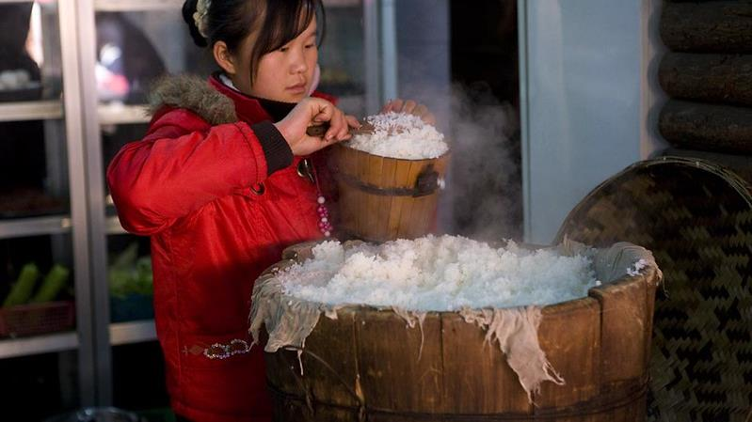
ASIA-PACIFIC
Data-driven assessment
Assessment of 28 Asian countries via:
  Database analyses
  Creation of country profiles
  Partner interviews and mapping
Priority tiers were identified through:
  Industry analyses
  Assessment of grain availability
  Assessment of fortification environment for wheat and rice
Photo: Steve Evans

Slide 23
Asia-Pacific:
Strategic approach to rice fortification
Number on color block below indicates number of countries in that color code.
 |  | Total Population (in millions) | Urban Population (in millions) | % of total Asian urban population
1 | Over 75% of industrially-milled flour available is fortified. | 22 | 20 | 1.7%
6 | Confident country will move to 75% by November 2012. | 361 | 155 | 13.1%
2 | Industrial milling processes and/or advocacy networks make fortification viable. Burden of disease can be addressed by fortification. Focused efforts to support current networks and fill gaps. | 100 | 46 | 3.9%
10 | No plan for significant time or finances to push fortification at this time. FFI will actively initiate and support grassroots efforts to advance fortification. | 1,770 | 762 | 64.4%
6 | The political environment and/or public perception does not favor fortification. Comparatively low burden of disease. FFI to engage in strategic advocacy and monitor the situation. | 315 | 184 | 15.5%
3 | Wheat fortification likely to have very limited health impact or is not feasible at this time. | 31 | 17 | 1.4%
 | Totals | 2,599 | 1,184 | 100%
Population and Urbanization figures from United Nations Population Division. Percents created using non-rounded population figures. Includes Australia, New Zealand and Fiji-not mapped.
Priority 1
Priority 2
Strategic
Advocacy

Slide 24
ASIA-PACIFIC
Strategic targets
FFI is supporting 7 countries and exploring opportunities in 2 countries between 2018-2021.
EXPLORE & ENGAGE | MAP THE CONTEXT | DESIGN & DEVELOP | MONITOR
Malaysia | Bangladesh | Indonesia | Solomon Islands
Papua New Guinea |  | Mongolia
 |  | Philippines
 |  | Sri Lanka
 |  | Viet Nam
Photo: Steve Evans

Slide 25
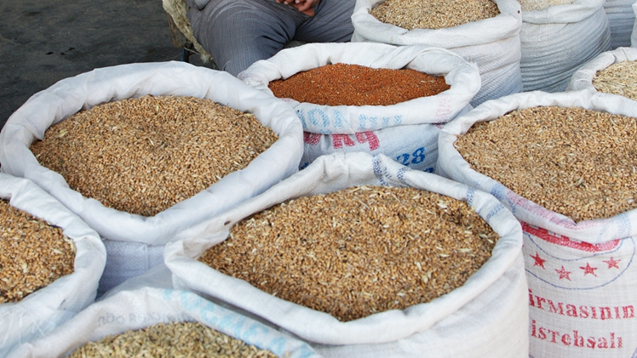
EUROPE
Data-driven assessment
Assessment of 49 European countries via:
  Database analyses
  Creation of country profiles
  Partner interviews and mapping
Priority tiers were identified through:
  Industry analyses
  Assessment of grain availability
  Assessment of fortification environment for wheat
Photo: Pierre/Flickr

Slide 26
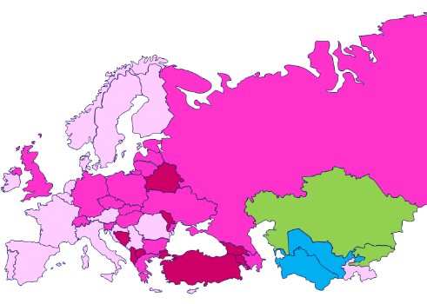
Europe:
Strategic approach to flour fortification
Number on color block below indicates number of countries in that color code.
 |  | Population (in millions) | % of Total European Population
2 | Over 75% of industrially-milled flour available in the country is fortified. | 32 | 3.6%
2 | Confident country will move to 75% by November 2012. | 21 | 2.4%
9 | Industrial milling processes and/or advocacy networks make fortification viable. Notable burden of disease that can be addressed by fortification. Efforts focused to support current networks and fill gaps. | 104 | 11.7%
16 | No plan to spend significant amounts of time or finances to push fortification at this time. FFI will actively initiate and support grassroots efforts to advance flour fortification. | 442 | 49.6%
20 | The political environment and/or public perception do not favor fortification. Comparatively low burden of disease. FFI will engage in strategic advocacy and monitor the situation. | 291 | 32.6%
 | Totals | 890 | 100%
Population figures from United Nations Population Division. Percents created using non-rounded population figures.
Priority 1
Priority 2
Strategic
Advocacy
Notes:
In Europe and Asia, we took a slightly different approach than in Africa. This is a new color-coding system that we came up with that points toward work plans.
*Kosovo is a priority country but cannot be colored to reflect this rank.
Blue: Turkmenistan, Uzbekistan
Green: Kazakhstan, Kyrgyzstan
Dark pink is Priority: Albania, Armenia, Belarus, Bosnia and Herzegovina, Georgia, Kosovo (not labeled on map), Macedonia, Republic of Moldova, Turkey
Medium pink is Maybe: Azerbaijan, Bulgaria, Germany, Poland, Russian Federation, Switzerland, Ukraine, United Kingdom, Czech Republic, Estonia, Greece, Hungary, Latvia, Lithuania, Slovakia, Slovenia
Light pink is Strategic Advocacy: Austria, Belgium, Croatia, Cyprus, Denmark, Finland, France, Ireland, Italy, Luxembourg, Malta, Montenegro, Netherlands, Norway, Portugal, Romania, Spain, Sweden, Serbia, Tajikistan

Slide 27
EUROPE
Strategic targets
FFI is prioritizing support to 8 countries between 2018-2021, pending additional funding.
EXPLORE & ENGAGE | MAP THE CONTEXT | DESIGN & DEVELOP | MONITOR
 | Ukraine | Azerbaijan | Turkmenistan
 |  | Georgia | Uzbekistan
 |  | Kazakhstan
 |  | Kyrgyzstan
 |  | Tajikistan
Photo: Pierre/Flickr

Slide 28
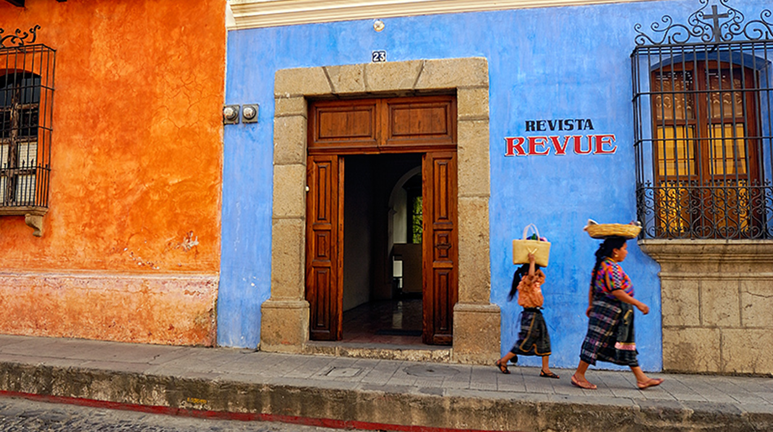
LATIN AMERICA & CARIBBEAN
Data-driven assessment
Wheat and maize flour fortification is mandatory in most countries in Latin America and the Caribbean.
Yet, our research suggests that standards need to be reviewed to ensure optimal nutritional impact.
Photo: Abe Kleinfeld

Slide 29
Sample Standards in South America
Country | Wheat g/capita/day | Extraction | Iron Compound | Iron (ppm) | Folic acid (ppm) | WHO
Argentina | 240 | 75% | Ferrous sulfate | 30 | 2.2 | Y
Bolivia | 153 | 75% | Reduced electrolytic iron | 60 | 1.5 | Y
Brazil | 146 | 75% | Reduced iron | 42 | 1.5 | N
Chile | 305 | 75% | Ferrous sulfate | 30 | 2.2 | Y
Colombia | 80 | 75% | Ferrous fumarate, sulfate or reduced iron | 45 | 1.5 | N
Ecuador | 104 | 75% | Reduced iron | 55 | 0.6 | N
Peru | 148 | 75% | Ferrous fumarate or ferrous sulfate | 55 | 1.2 | Close
Uruguay | 336 | 75% | Ferrous sulfate and fumarate | 30 | 2.4 | High
Venezuela | 144 | 75% | Ferrous fumarate or equivalent | 20 | 0 | Low

Slide 30
LATIN AMERICA & CARIBBEAN
Strategic targets
FFI is exploring support for 26 countries, pending additional funding.
EXPLORE & ENGAGE
Argentina | Costa Rica | Honduras | Trinidad and Tobago
Bahamas | Cuba | Jamaica | Uruguay
Barbados | Dominican Republic | Mexico | Venezuela
Belize | Ecuador | Nicaragua
Bolivia | El Salvador | Panama
Brazil | Guatemala | Paraguay
Chile | Guyana | Peru
Colombia | Haiti | Suriname
Photo: Abe Kleinfeld
Notes:
Proposed activities, pending funding:
In Latin America, wheat flour and maize flour fortification is common in industrial mills, but rice fortification is not regularly practiced. In 13 Latin America countries, more than 75 grams of rice per person per day is available for consumption, making it a food worth considering for fortification. In eight countries (Costa Rica, Cuba, Dominican Republic, Ecuador, Guyana, Haiti, Panama, and Suriname), more rice than maize or wheat products is available, according to FAO. Costa Rica and Panama already have legislation to fortify rice.
To assess other opportunities for rice fortification in this region, FFI would:
Analyze the supply chain of wheat flour, maize flour, and rice
Determine the feasibility of fortifying rice based on industry capacity
Recommend whether fortified rice would add value to countries' existing fortification program

Slide 31
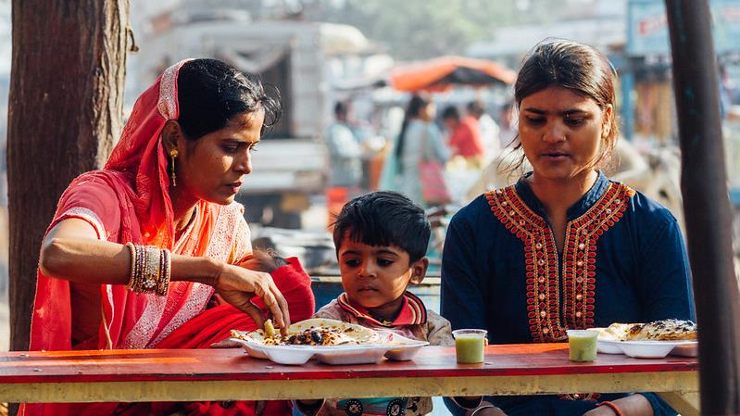
INDIA
Data-driven assessment
Assessment of 28 states and 7 territories via:
  Database analyses
  Creation of state profiles
  Socio-cultural assessment
  Partner interviews and mapping
Priority tiers were identified through:
  Potential health impact
  Market analyses
  Industry analyses
  Assessment of grain availability and consumption
  Assessment of fortification environment for wheat and rice
Photo: Adam Cohn

Slide 32
FFI Strategic Approach: Rice & Wheat
Wheat Channel Legend
PA = PDS Atta
CA = CCM Atta
RA = RFM Atta
RM = RFM Maida
No reachable pop.
Low ranking
Low-intermediate
Intermediate-high
High ranking
Rice Legend
 | First Priority State
 | Second Priority State
 | Third Priority State
PA
CA RA
RM
Bihar
PA
CA RA
RM
PA
CA RA
RM
Jharkhand
PA
CA RA
RM
West Bengal
Chattisgarh
Orissa
PA
CA RA
RM
Notes:
Northern India

Slide 33
FFI Strategic Approach: Rice & Wheat
*Meghalaya and Assam were the only states assessed in the N.E.
Wheat Channel Legend
PA = PDS Atta
CA = CCM Atta
RA = RFM Atta
RM = RFM Maida
No reachable pop.
Low ranking
Low-intermediate
Intermediate-high
High ranking
Rice Legend
 | First Priority State
 | Second Priority State
 | Third Priority State
Arunachal Pradesh
Sikkim
RM
CA
Assam
Nagaland
RA
PA
RA
Meghalaya
RM
CA
PA
Manipur
Tripura
Mizoram
Notes:
North Eastern India

Slide 34
FFI Strategic Approach: Rice & Wheat
Jammu &
Kashmir
RM
CA
Wheat Channel Legend
PA = PDS Atta
CA = CCM Atta
RA = RFM Atta
RM = RFM Maida
No reachable pop.
Low ranking
Low-intermediate
Intermediate-high
High ranking
RA
PA
Rice Legend
 | First Priority State
 | Second Priority State
 | Third Priority State
RM
CA
RM
CA
Himachal Pradesh
RA
PA
RA
PA
RM
CA
Punjab
PA
Uttarakhand
RA
Haryana
RM
CA
RA
PA
RM
CA
Rajasthan
Uttar Pradesh
RA
PA
RM
CA
RA
PA
Gujarat
RM
CA
RM
CA
Madhya Pradesh
RA
PA
RA
PA
Notes:
North Western India

Slide 35
FFI Strategic Approach: Rice & Wheat
*Goa not assessed
Wheat Channel Legend
PA = PDS Atta
CA = CCM Atta
RA = RFM Atta
RM = RFM Maida
No reachable pop.
Low ranking
Low-intermediate
Intermediate-high
High ranking
RM
CA
Rice Legend
 | First Priority State
 | Second Priority State
 | Third Priority State
RA
PA
Maharashtra
Andhra Pradesh
RM
CA
Karnataka
Goa
RA
PA
RM
PA
CA
RA
Tamil Nadu
RM
CA
Kerala
RM
CA
RA
PA
RA
PA
Notes:
Southern India
Goa had no consumption data

Slide 36
INDIA
Strategic targets
FFI is targeting 18 states in India, including the scale-up of fortified atta in all social safety net programs in Haryana. Pending additional funding, FFI will prioritize support for 17 additional states.
EXPLORE & ENGAGE |  | MAP THE CONTEXT | DESIGN & DEVELOP | MONITOR
Andhra Pradesh | Karnataka | Maharashtra | Haryana
Bihar | Kerala | Rajasthan
Chhattisgarh | Madhya Pradesh | West Bengal
Gujarat | Odisha
Himachal Pradesh | Punjab
Jammu & Kashmir | Tamil Nadu
Jharkhand | Uttar Pradesh
Photo: Adam Cohn
Notes:
Proposed activities, pending funding:
The Food Fortification Initiative (FFI) has identified 18 states in India with potential for fortified rice or wheat flour in various market channels. Wheat flour fortification in the government’s Public Distribution System (PDS) has successfully moved forward in the state of Haryana. FFI has provided technical support in Haryana by conducting a wheat supply chain analysis, calculating the costs for the government to supply fortified wheat flour in the PDS system, and ensuring consumer acceptance of the fortified product.
For the remaining 17 states, FFI proposes examining the current political environment to determine which states have leadership willing to support grain fortification with at least iron, vitamin B12, and folic acid. For the identified states, FFI would conduct an assessment to include:
Industry capacity to fortify flour and/or rice using published reports and interviews with millers
Current wheat flour and rice consumption patterns based on existing survey data
Potential distribution channels such as the PDS and open market, and the reach of each distribution channel
Next, FFI would present results of this assessment to state leaders and, building on the successful Haryana model, collaboratively develop practical, operational plans to fortify grains in each state. Activities would include:
Promote mandatory fortification so that costs and health benefits are shared equally Create awareness about nutritional deficiencies, their consequences, and benefits of fortification
Generate commitment among influential multi-sector leaders to support fortification
Train millers to fortify their wheat flour and rice according to national standards Develop sustainable procedures for internal and external monitoring to ensure compliance with India’s fortification standards
Share the strategy with other nutrition groups in India to avoid duplication of efforts
FFI’s vision is for mandatory, sustainable grain fortification to be implemented and monitored in all 18 states.

Slide 37
